Slide 1




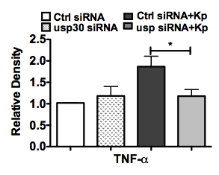


A
MH-S
MLE-12 cells
usp30
GAPDH
Kp
0 1 2 5 h
0 1 2 5 h
B
TNF-α
GAPDH
Ctrl siRNA
usp30 siRNA
+
−
−
+
+
−
−
+
Control
Kp
Supplementary Figure 6

