Slide 1
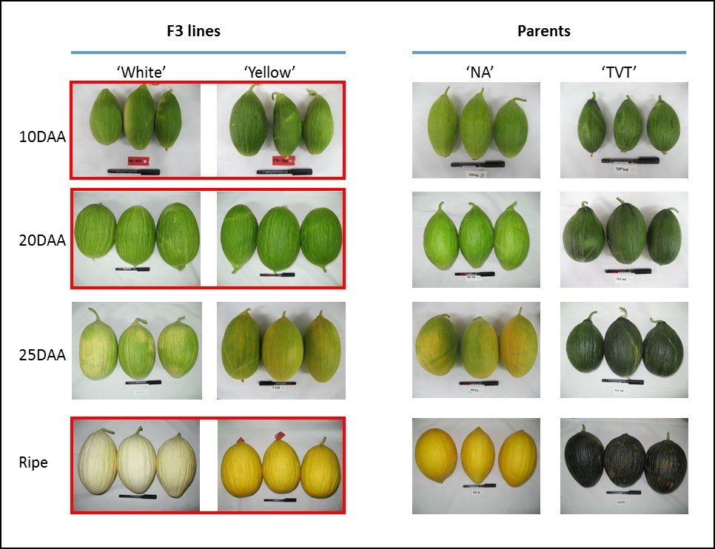
Supplemental Figure S1. F₃ population establishment. Developing fruit of parental lines ‘NA’ and ‘TVT’ and F₃ families: ‘White’ – representing developing fruit of 7 families with low chlorophyll and low NarCh contents, ‘Yellow’ – representing developing fruit of 12 families with high NarCh and low chlorophyll contents. Three developmental stages (framed in red), consisting of 3 biological repetitions of each family, were subjected to further biochemical and RNA-Seq analyses.

