Slide 1
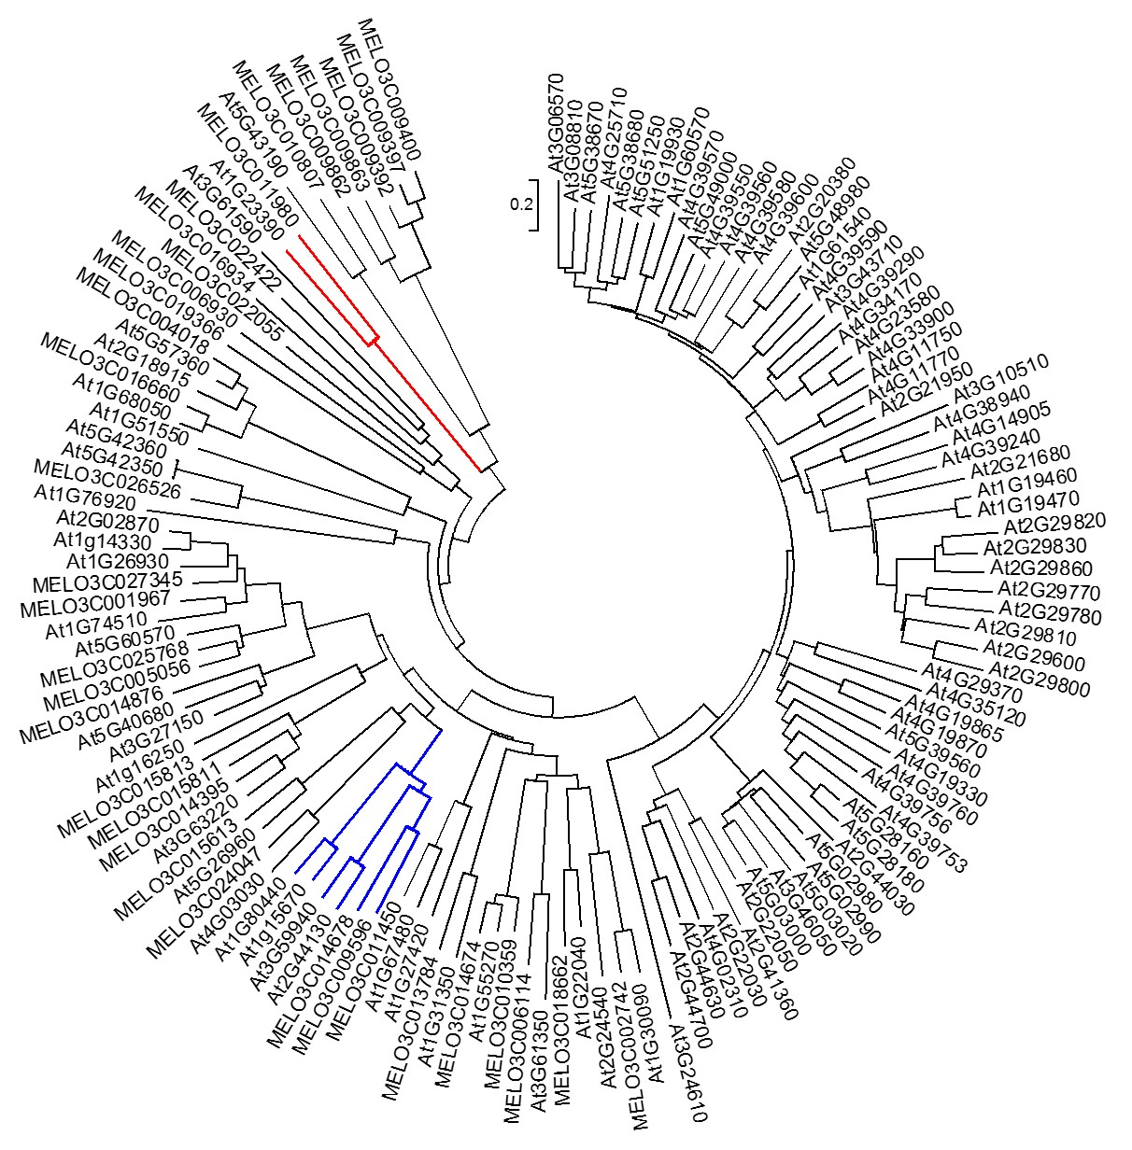
Supplemental Figure S10. Phylogenetic analysis of KFB proteins in melon and Arabidopsis. Subtree colored in blue contains the four Arabidopsis KFB proteins, KFB01 (At1g15670), KFB20 (At1g80440), KFB39 (At2g44130), and KFB50 (At3g59940), which were shown to regulate PAL degradation, in addition to the melon ME3C014678 and MELO3C009596. Subtree colored in red contains CmKFB (MELO3C011980) and the Arabidopsis At1g23390.
.

