Slide 1
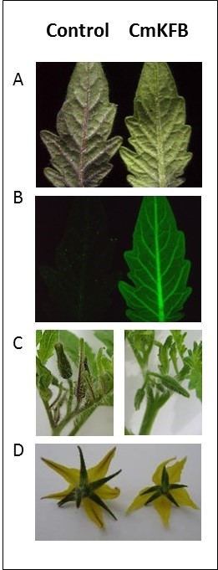
Supplemental Figure S11. Over-expression of CmKFB in stable transgenic T₀ tomato plants. A-D, T₀ transgenic plant (right) and the control (left). A, Leaves under visible light after cold stress. B, GFP fluorescence of same leaves. C, Developing shoot meristem of mature plant with flower buds. D, Flower petals (note the purple line in the middle of control's flower petals).

