Slide 1
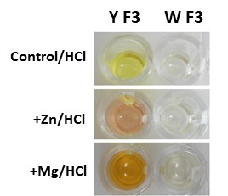
Supplemental Figure S3. Additional staining methods. Methanol extracts of ‘yellow’ F₃ bulk (Y F3) and ‘white’ F₃ bulk (W F3) analyzed for a visual color change with Zn/HCl (Pew’s test) or Mg/HCl (Shinoda’s test) in ELISA plate wells.

