Slide 1
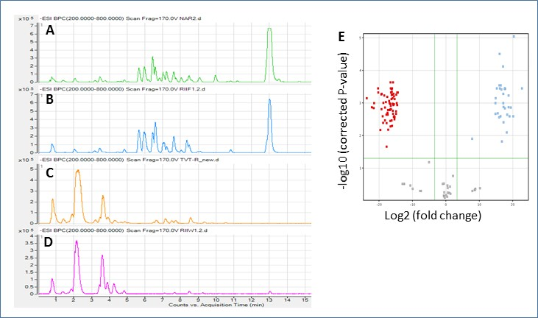
Supplemental Figure S4. LC-MS analysis of fruit rind methanolic extracts. A-D, base peak chromatograms (BPC) of mass range m/z 200-800, in ESI negative mode. A, ‘NA’ parent. B, Bulk of ‘yellow’ F₃. C, ‘TVT’ parent. D, Bulk of ‘white’ F₃. E, a volcano plot indicating specific compounds that differentially accumulated (P< 0.05, minimum 10 fold difference) in the ‘NA’ & ‘yellow’ F₃ group (red) or in the ‘TVT’ & ‘white’ F₃ group (blue).

