Slide 1
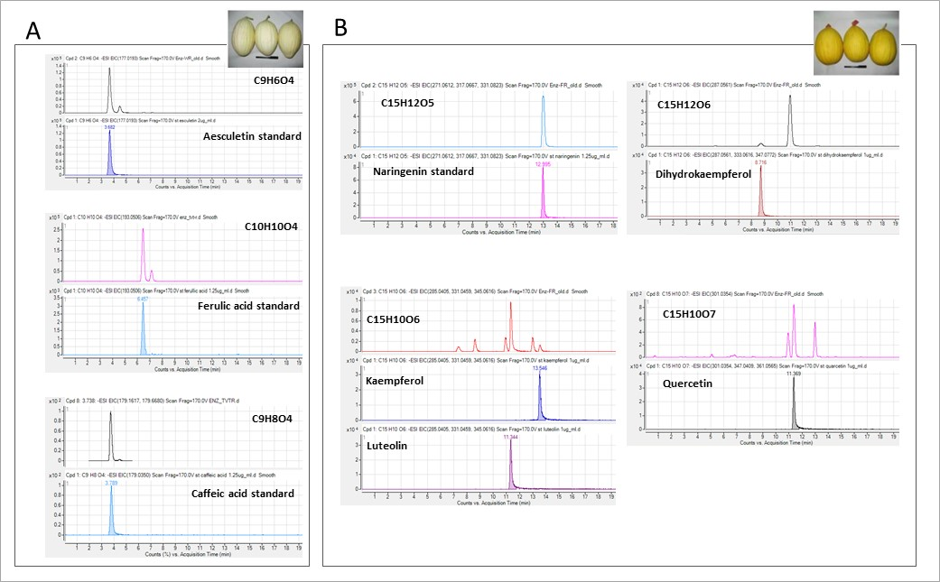
Supplemental Figure S5. Fruit rind compound identification. Identification of eight compounds, significantly differentiating the two NarCh accumulating groups. A, Three compounds over-accumulated in both’ TVT’, and ‘white’ F₃ bulk: caffeic acid, ferulic acid and aesculetin. Each specific mass identified (upper panel) with an analytical grade authentic standard (lower panel). B, Five compounds over-accumulated in the NarCh accumulating group (‘NA’ parent, and ‘yellow’ F₃ bulk): naringenin, kaempferol, luteolin, dihydrokaempferol (traces), and quercetin. Each specific mass identified (upper panel) with analytical authentic standard (lower panel).

