Slide 1
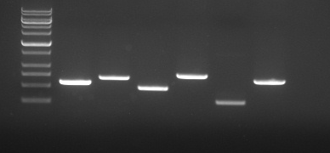
S1 Fig
1500
1000
750
500
250 bp
hylF
iucD
papC
fyuA
irp2
iroN
PCR amplification for detecting the virulence genes of E. coli strain KBP1315.
Lanes: M, Sizer 1000 DNA Marker (Intron); and 1 to 6, fragments corresponding to hylF (480 bp), iucD (680 bp), papC (470 bp), fyuA (700 bp), irp2 (250 bp), and iroN (630 bp), respectively.

