Slide 1
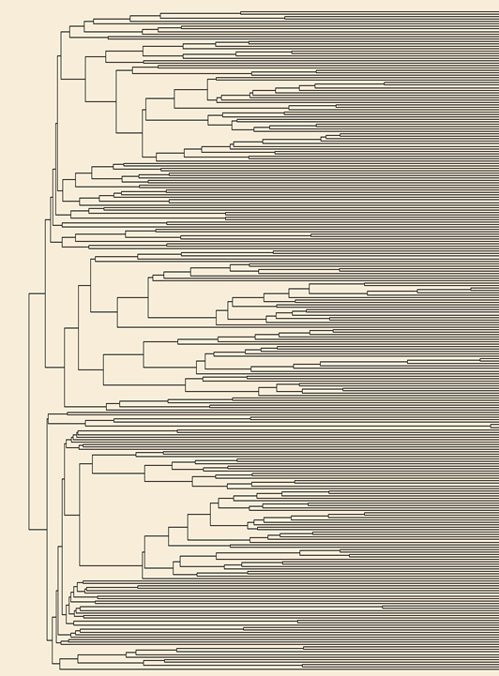
Non-Stiff Stock inbred lines
Stiff Stock inbred lines
Tropical inbred lines
Additional file 5. Phylogenetic tree of maize accessions in Association Panel

