Slide 1
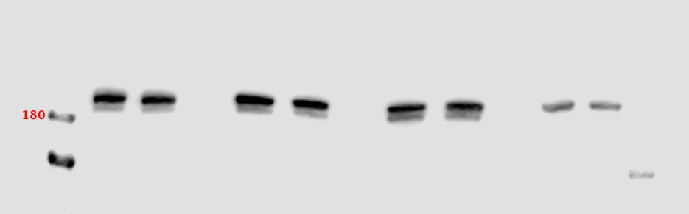
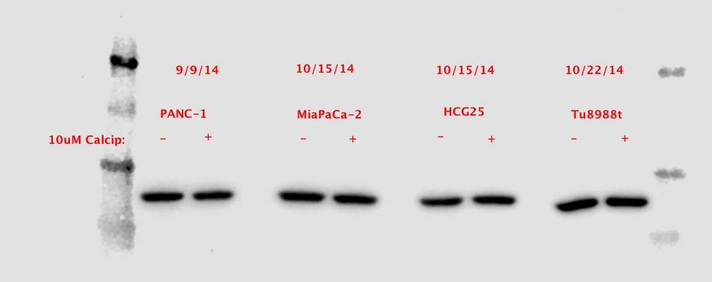
Supplemental Figure 2
A
MiaPaCa-2
PANC-1
HCG25
Calcipotriol:
-
+
-
+
-
+
LRP6
Tubulin

