Slide 1
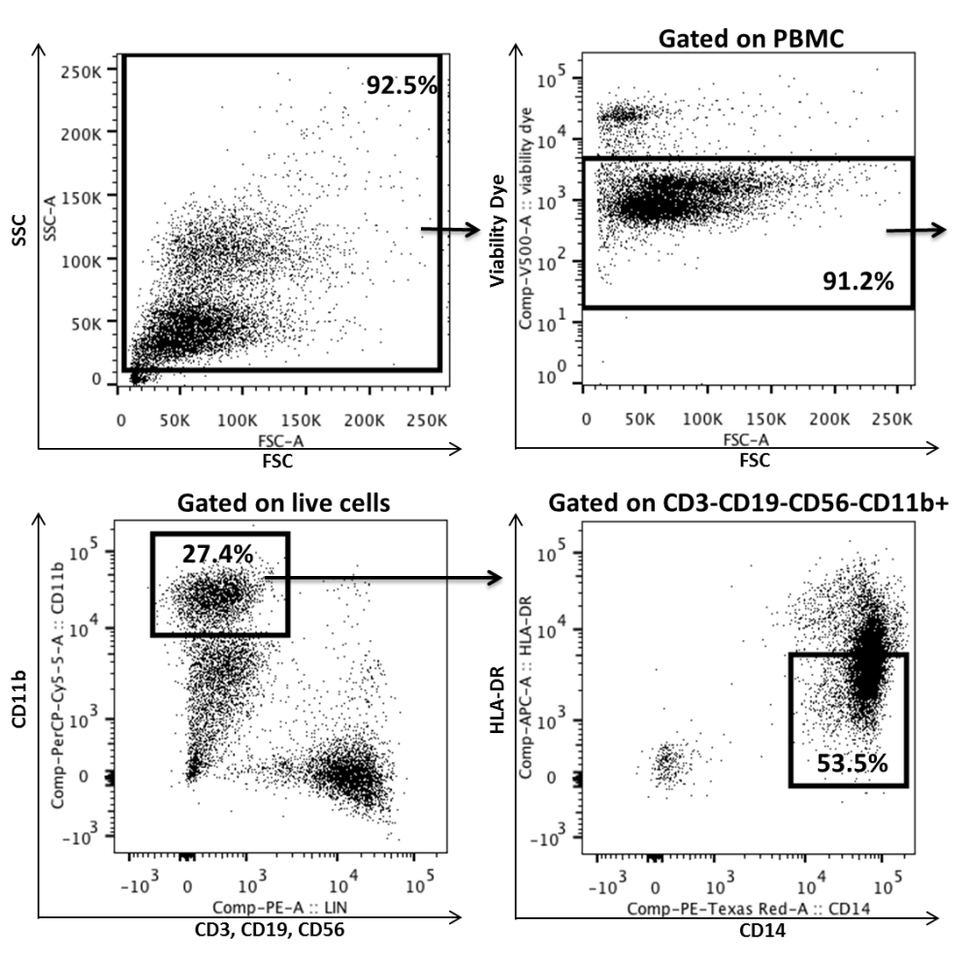
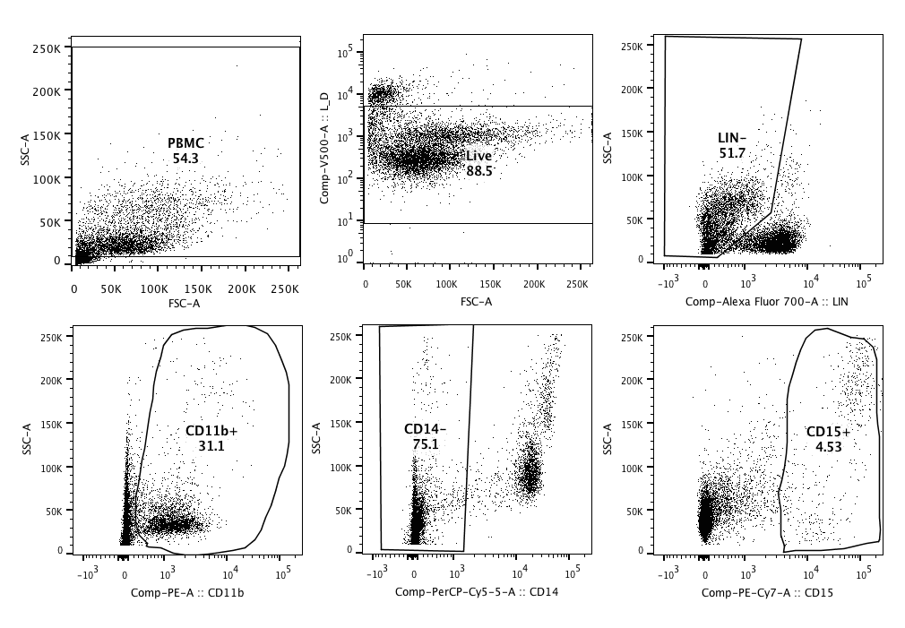
Supplemental Figure 1.
A
B

Slide 2
Supplemental Figure 2.

