Slide 1
Supplement Figure S1. Hematoxylin and eosin (H&E) and immuno-histochemical characterization of epithelial lesions, NE-Ca and metastatic lymph nodes.
Epithelial lesions (upper) and NE-Ca’s (lower) from TRAMP mice were stained for H&E, SV40-T antigen (T-Ag), synaptophysin (SYP), and androgen receptor (AR). Magnification, 200×.
Enlarged pelvic lymph nodes stained for H&E, SV40-T antigen (T-Ag+) and synaptophysin (Syp+). Magnification, 200×. M marks metastatic area. L marks lymph node area.
The incidence of NE-tumor metastasis to pelvic lymph nodes (Chi square test, AGN/D/DA combined vs. Vehicle, p=0.035)., and the average weight of enlarged lymph nodes. Mean ± SD.

Slide 2
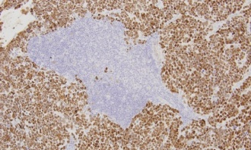
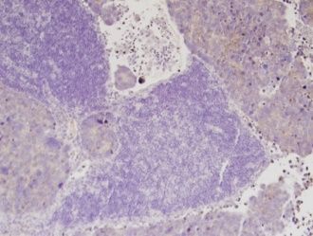
Supplemental Figure S1.
A. H&E and T-Ag, Synaptophysin (Syp), and AR IHC staining of epithelial lesions and NE-Ca's. Positive signal =dark brown staining
H&E T-Ag Syp AR
TRAMP Epithelium
NE-Ca
B. H&E and T-Antigen and synaptophysin IHC staining of enlarged pelvic lymph nodes (L = lymphocytes; M= metastasis) Positive signal = dark brown staining
H&E T-Antigen Synaptophysin
Vehicle
AGN
L
M
L
M
L
M
D/DA
M
L
M
L
M
L
C. Incidence of NE-Ca metastasis to pelvic lymph nodes, and weight of enlarged lymph nodes.
Group | Incidence (%) | Lymph node weight (mg)
Vehicle | 7/7 (100.0%) | 106.5±38.8
AGN | 3/6 (50.0%) | 52.8±18.0
D/DA | 3/8 (37.5%) | 34.1±3.7

