Slide 1
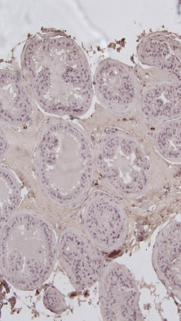
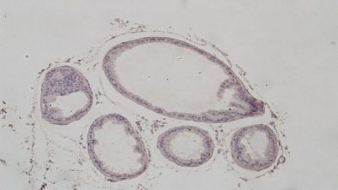
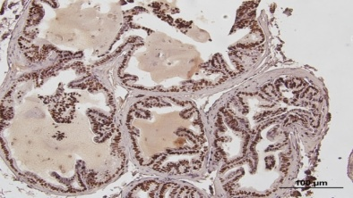
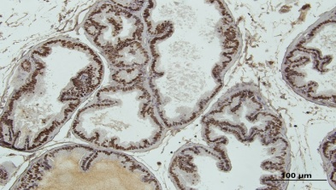
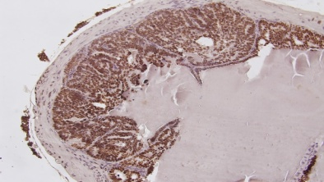
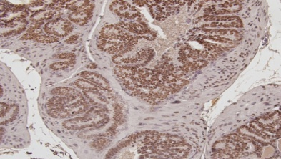
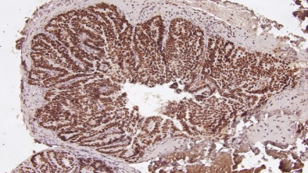
Supplemental Figure S2A. TRAMP prostate epithelial lesion scoring guide. Pictorial examples
 |  |  | AP | DLP | VP
Wild type mice Grade 0 | Grade Code | Lesion Score
TRAMP mice Mild hyperplasia Grade I | I.F I.M I.D | 1 2 3
TRAMP mice Moderate hyperplasia Grade II | II.F II.M II.D | 4 5 6
TRAMP mice Severe hyperplasia Grade III | III.F III.M III.D | 7 8 9
TRAMP mice Severe hyperplasia Grade IV | IV.F IV.M IV.D | 10 11 12
TRAMP mice Adenoma Grade V Size > 500 micrometer | V.F V.M V.D | 13 14 15 | Distribution pattern code: F = focal 1-2 foci M = Multi-foci > 3 (area <=30%) D = diffuse (area > 30%) |  | *:T-Ag stain: brown, nuclear
2
3

Slide 2
Supplemental Figure S2B. TRAMP prostate epithelial lesion scoring guide. Description of lesions.
Grade | Brief description Histologic features | Distribution pattern | Lobe score
I | Simple flat lesions (hyperplasia), increased crowding of epithelial cells, epithelial arrangement generally conforms to that occurring in normal gland | Focal Multifocal Diffuse | 1 2 3
II | Papillary or cribriform structures, single-layered appear within grade I lesions as areas of focal piling-up of cells, still oriented toward basement or with piling of cells (hyperplasia) membrane | Focal Multifocal Diffuse | 4 5 6
III | Papillary or cribriform lesions protruding epithelium assumes a cribriform or papillary pattern, projects into lumen either focally or diffusely into lumen (hyperplasia) throughout lobe, proliferating epithelium still follows outline of acinus, and acinar structure of gland is apparent, proliferative smooth muscle reaction may be apparent in acinar capsule (anterior and dorsal lobes) | Focal Multifocal Diffuse | 7 8 9
IV | Lesions occupying significant proportion Lumen of acinus becomes completely filled with epithelium, smooth muscle reaction in anterior and of lumen (adenoma) dorsal lobes more pronounced | Focal Multifocal Diffuse | 10 11 12
V | Lesions filling and expanding lumen, or a Lesions fill acinus which becomes expanded by the epithelial mass, proliferating epithelium is either distinct epithelial mass within the lumen diffusely arranged throughout acinar wall, or a distinct mass or masses fill lumen (adenoma) Size/diameter of lesion should exceed 500 micrometers. | Focal Multifocal Diffuse | 13 14 15

