Slide 1
Supplemental figure S1. Workflow for miRNA identification in spruce
STEPS
CRITERIA
Preprocessing
  Read quality
  Adaptor trimming
  Read sequence collapse
Genome mapping
  Map read to the spruce genome (Pabies1.0-genome.fa) using Patman-1.2.2
Preliminary filter
  Raw abundance ≥ 10
  Length between 20-22 nt
  Genomic matches on genome ≤ 20
Stem-loop structure screen
(modified miREAP)
  minimal space size between miRNA and miRNA*: 5
  minimal pair of miRNA and miRNA*: 14
  maximal bulge of miRNA and miRNA*: 3
  maximal asymmetry of miRNA/miRNA* duplex: 3
Homology search
  BLAST against miRBase, version 20
    (≤ 4 nucleotide differences)
Strict filter
(applied to at least one library)
Strand bias filter: sense/total ≥ 0.9
Abundance bias: (Top1 + Top2) / total ≥ 0.7 for novel miRNAs and 0.4 for known miRNAs
With star sequence found in corresponding library
Manual check
MIRNA locus redundancy remove
MIRNA structure check
Novel miRNA family classification
Novel miRNA name assignment
Spruce miRNAs
(585 precursors with 426 unique miRNAs)
52 known miRNA families
(313 precursors with 185 unique miRNAs)
181 novel miRNA families
(272 precursors with 241 unique miRNAs)

Slide 2
Supplemental figure S2. Coding and non-coding classification of PHAS genes
PHAS locus search
2,061 loci
(1) Does not code an appreciable peptide
( ≤ 100 amino acids)
1,001 loci
1,025 loci
(2) Not good protein-coding potential, CPC score
(evaluated by CPC-0.9-r2)
196 loci
(CP ≥ 0)
215 loci
(-1 < CP < 0)
614 loci
(CP ≤ -1)
(3) No significant homology to known protein
(BLASTX to UniRef90, e-value < 1e-4)
155 loci
(E ≤ 1e-4)
60 loci
(E > 1e-4)
1,420 loci
674 loci
68 loci
(4) No overlap with annotated coding genes
(Pabies1.0_HC.gff3)
Coding PHAS loci
606 loci
Non-coding PHAS loci
300 loci

Slide 3
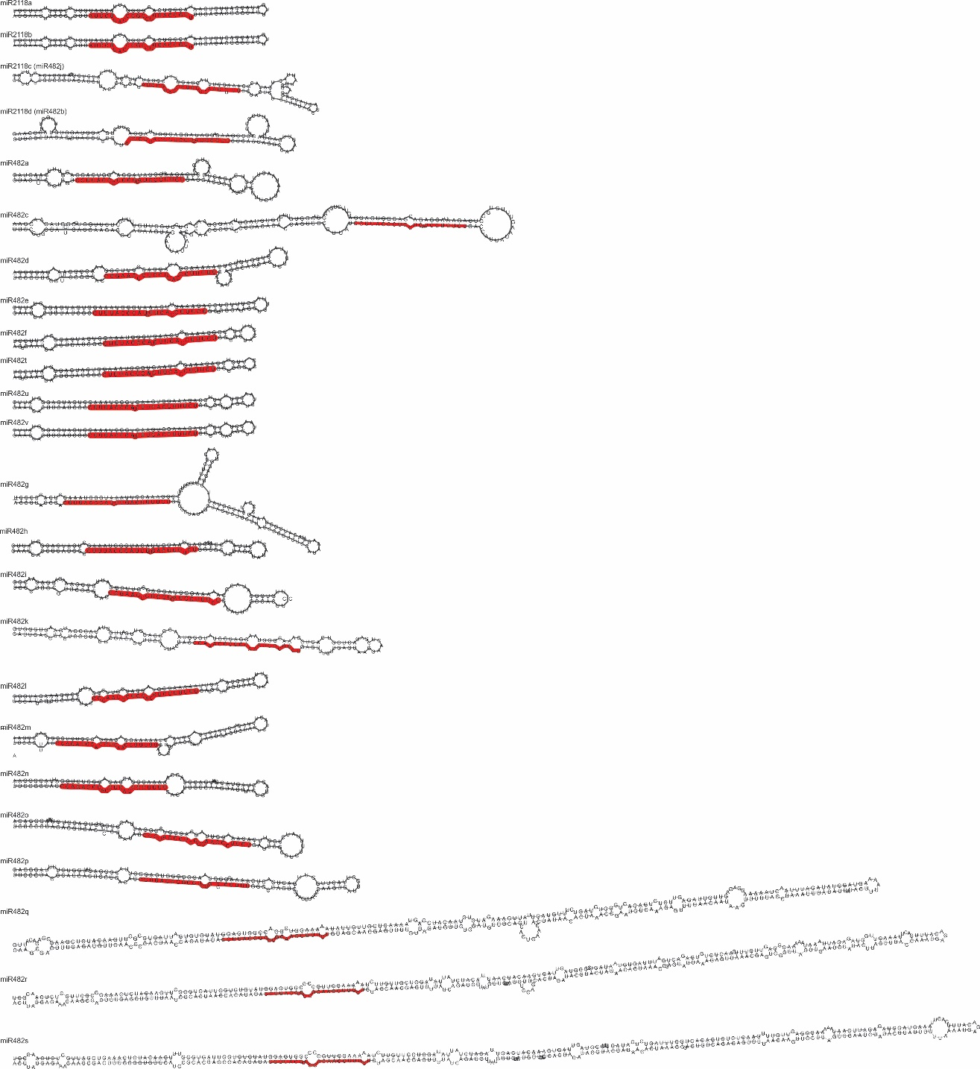
Supplemental figure S3. Stem-loop structures of miR482/2118 in spruce
miRNA sequence is highlighted in red

