Slide 1
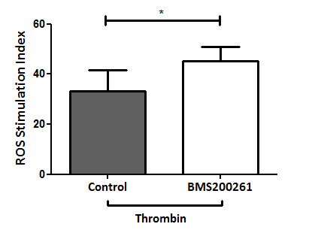
Supplementary Fig. 1. Specificity of antagonists

Slide 2
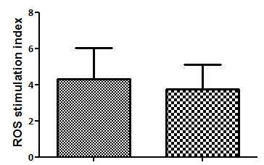
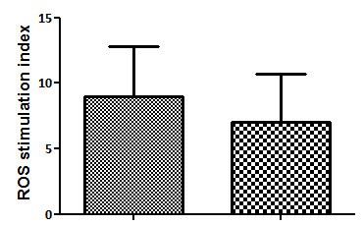
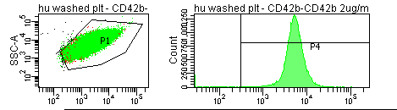
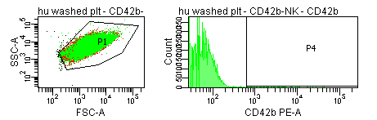
Supplementary Fig. 2. CRP and PMA/A23187-induced ROS generation in PAR4 KO platelets
A
B
WT
PAR4 KO
WT
PAR4 KO
CRP
PMA/A23187
Supplementary Fig. 3. Nk-protease treatment of platelets
No Nk protease treatment
Nk protease treatment

Slide 3
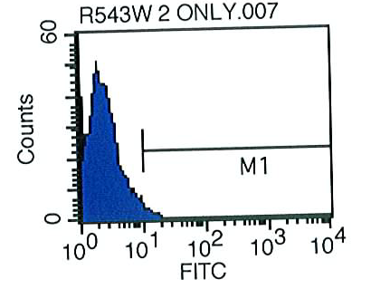
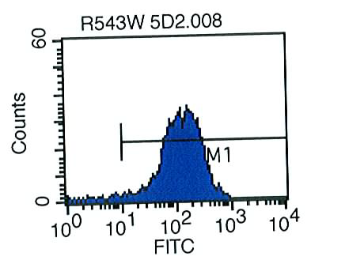
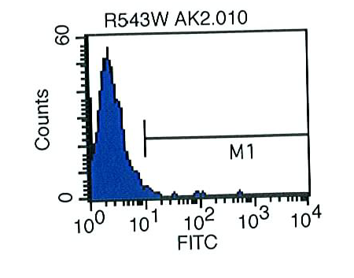
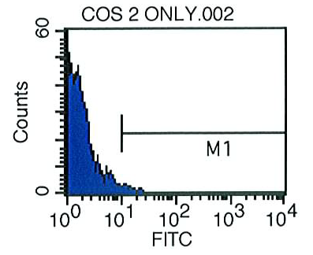
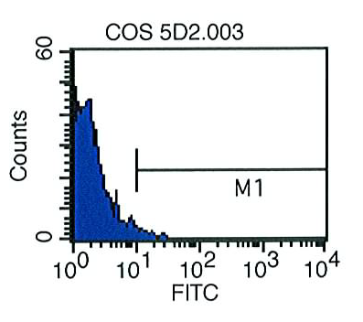
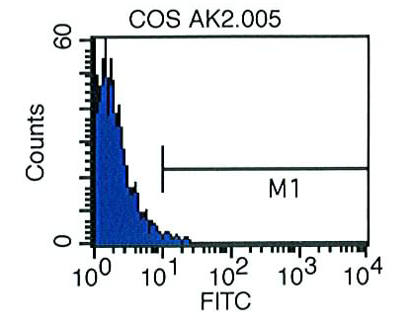
Supplementary Fig. 4. Expression of VWF-A1 domain on R543W cells
R543W Cells
A
B
C
No Addition R543W cells
R543W cells + 5D2
R543W cells + AK2
WT Cells
No Addition COS-7 cells
WT cells + 5D2
WT cells + AK2

