Slide 1
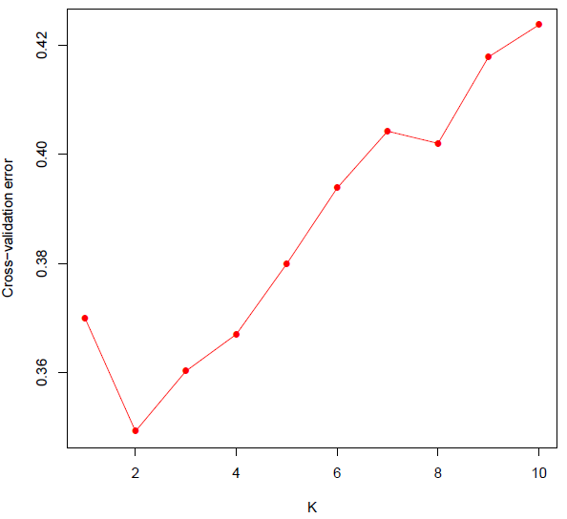
Notes:
Figure S1

