Slide 1
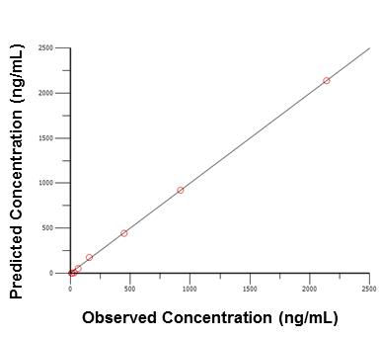
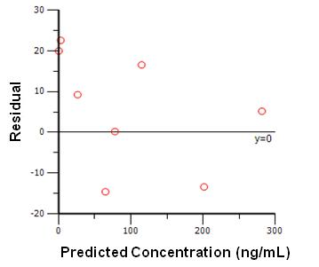
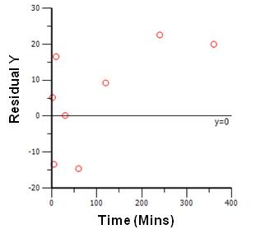
A
B
C
D
E
Correlation Matrix
Summary Table showing observed and predicted concentrations
PARAMETER | V1 | K10 | K12 | K21
V1 | 1
K10 | -0.78439 | 1
K12 | -0.73596 | 0.406535 | 1
K21 | -0.37507 | 0.468646 | 0.508105 | 1
Time (Mins) | Concentration Observed (ng/mL) | Concentraion Predicted (ng/mL) | Residual | Weighting | Standard Residual
2 | 2138.33 | 2137.96 | 0.37 | 1 | 1.32
5 | 919.66 | 921.84 | -2.18 | 1 | -1.35
10 | 450 | 443.09 | 6.9 | 1 | 1.35
30 | 159.33 | 174.8 | -15.47 | 1 | -1.24
60 | 66 | 52.34 | 13.65 | 1 | 0.87
120 | 33 | 4.69 | 28.3 | 1 | 1.39
240 | 17 | 0.038 | 16.96 | 1 | 0.83
360 | 10.66 | 0.000304 | 10.67 | 1 | 0.52
Supp. Fig. 2. Additional PK parameters for the confirmation of 2-compartment model. (A) Plot of Predicted Concentration vs. Observed Concentration, (B) Plot of Residual vs. Predicted Concentration, (C) Plot of Residual Y vs. Time, (D) Values of correlation matrix and (E) Summary of observed and predicted concentrations

