Slide 1
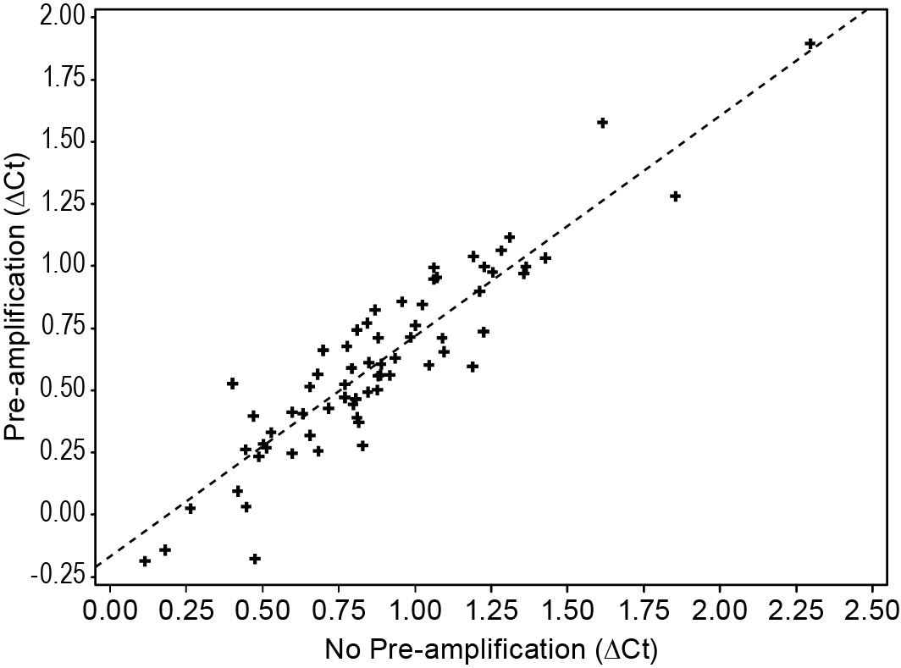
Supp Figure 1

