Slide 1
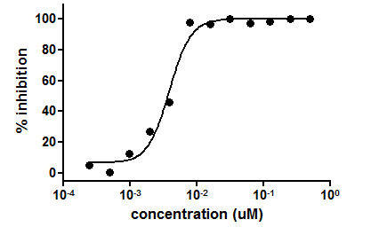
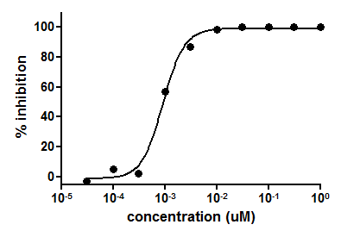
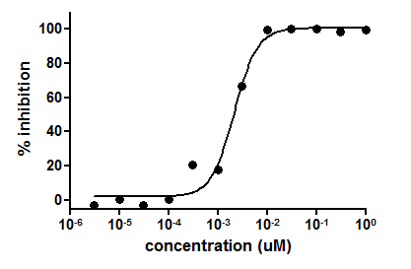
A
B
KRC-00509
KRC-00715
C
Crizotinib
Supplementary Figure 1

Slide 2


A
KRC-509 200nM
KRC-509 1,000nM
Crizotinib 40nM
Crizotinib 200nM
Crizotinib 1,000nM
B
KRC-509 200nM
KRC-509 1,000nM
Crizotinib 40nM
Crizotinib 200nM
Crizotinib 1,000nM
KRC-509 8nM
KRC-509 40nM
Crizotinib 8nM
KRC-509 8nM
KRC-509 40nM
Crizotinib 8nM
DMSO
DMSO
DMSO
DMSO
pMet
pMet
pErk
pErk
pAkt
pAkt
Tubulin
Tubulin
SNU-638
SNU-620
KRC-509 200nM
KRC-509 1,000nM
Crizotinib 40nM
Crizotinib 200nM
Crizotinib 1,000nM
C
KRC-509 1,000nM
Crizotinib 1,000nM
D
KRC-509 8nM
KRC-509 40nM
Crizotinib 8nM
KRC-509 40nM
KRC-509 200nM
Crizotinib 8nM
Crizotinib 40nM
Crizotinib 200nM
KRC-509 8nM
DMSO
DMSO
DMSO
DMSO
pMet
pMet
pErk
pAkt
pAkt
pErk
Tubulin
Tubulin
SNU-1
MKN-1
Supplementary Figure 2

Slide 3

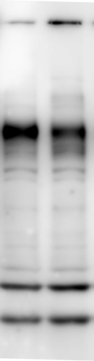
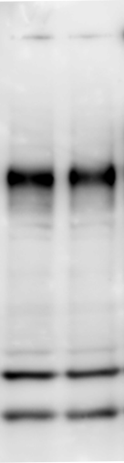
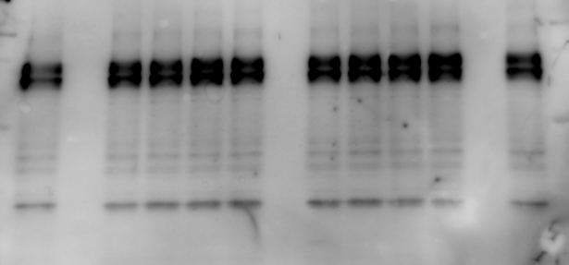
KRC-00509 30nM
Crizotinib 30nM
KRC-00509 100nM
Crizotinib 100nM
KRC-00509 200nM
KRC-00509 1,000nM
Crizotinib 1,000nM
KRC-00509 8nM
KRC-00509 40nM
Crizotinib 8nM
Crizotinib 40nM
Crizotinib 200nM
A
B
DMSO
DMSO
DMSO
250
250
150
150
100
100
75
75
Hs746T
AGS
Supplementary Figure 3

