Slide 1
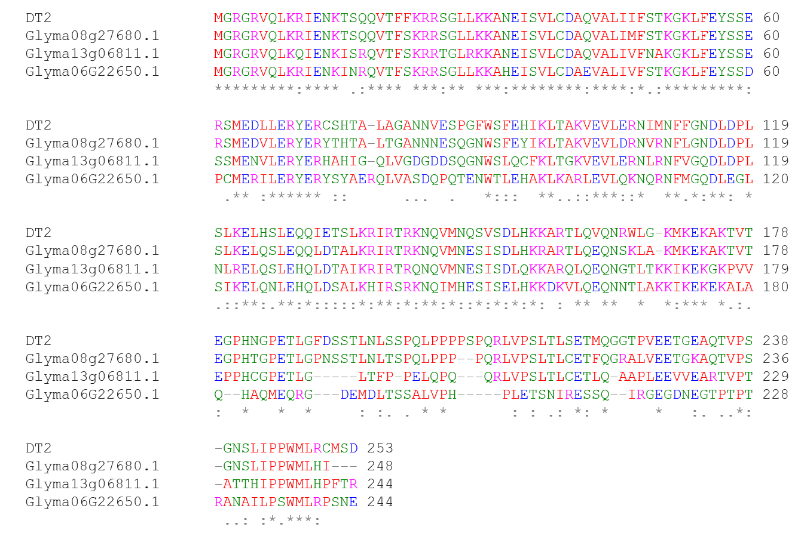
Title: Innovation of a Regulatory Mechanism Modulating Semi-determinate Stem Growth through Artificial Selection in Soybean.
Authors: Yunfeng Liu, Dajian Zhang, Jieqing Ping, Shuai Li, Zhixiang Chen, and Jianxin Ma
S2 Fig.

