Slide 1
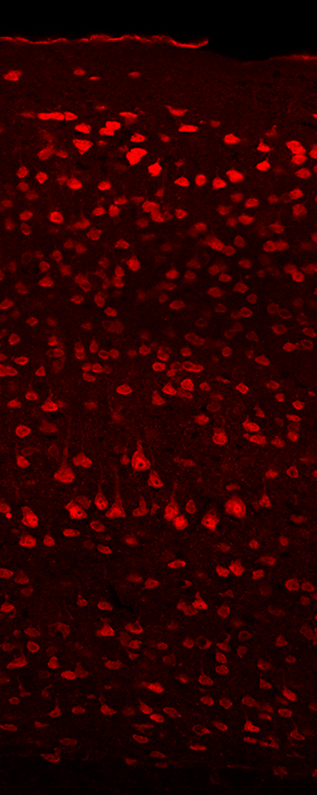
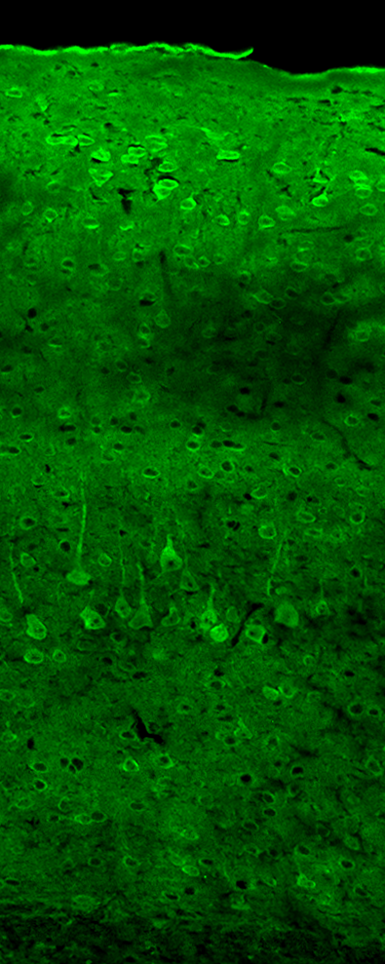
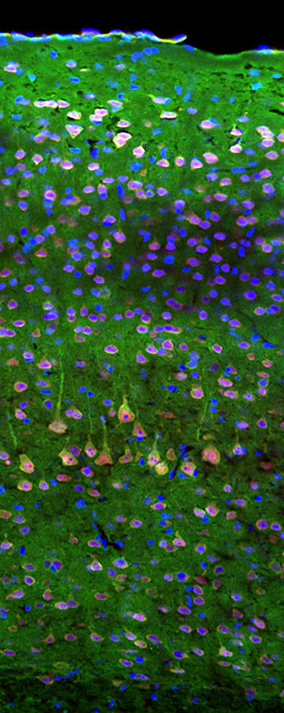
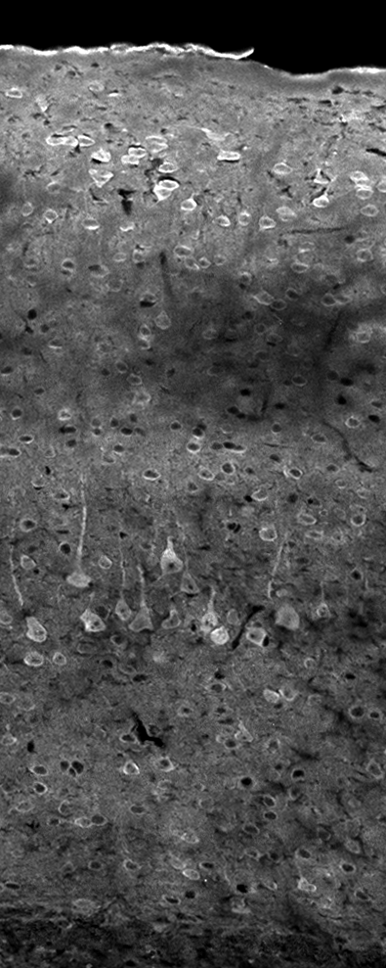
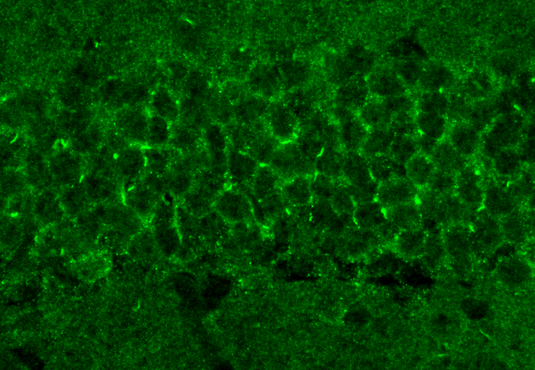
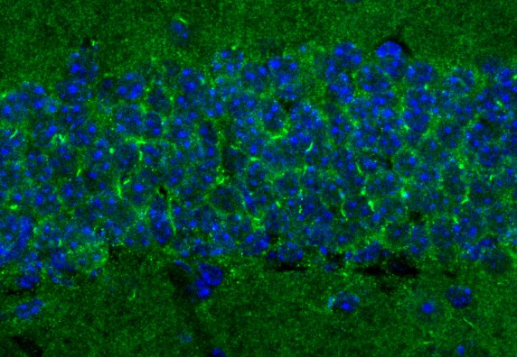
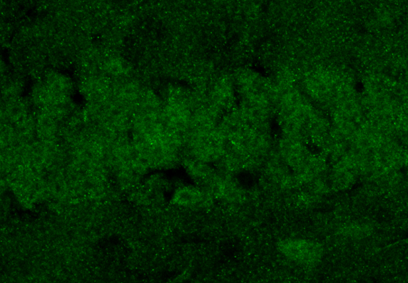
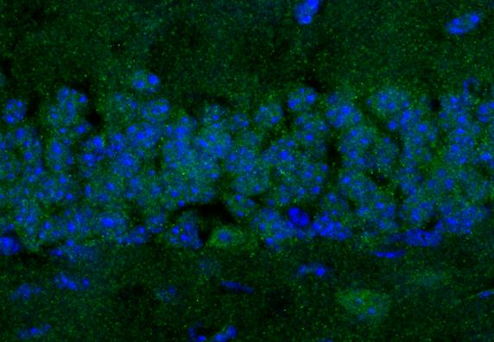
Fig. S1
A
NeuN
PCL
Merge
PCL
B
PCL
Merge
Pkdl^{+/+}
PCL
Merge
Pkdl^{-/-}
Supplementary Fig. 1. (A) Confocal images revealed somatic cytoplasmic labeling of PCL in neuronal cells of cerebral cortex (layers II to VI). (B) Immunofluorescence images show that the PCL signal is abolished in KO mouse brain, compared to WT littermates. Images were taken in the dentate gyrus region of hippocampus.
Notes:
10X Cortex is cropped to arrange the pics looked well.

Slide 2
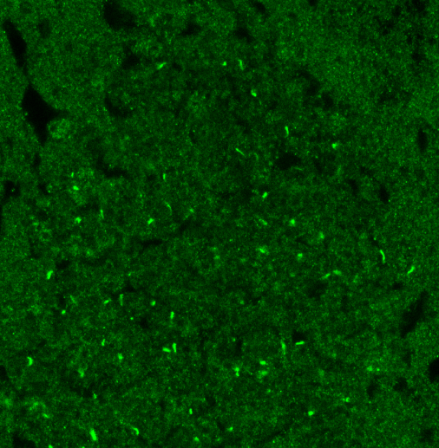
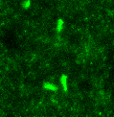
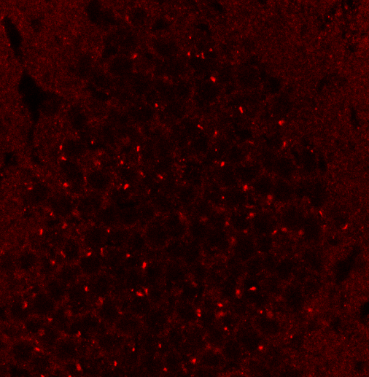

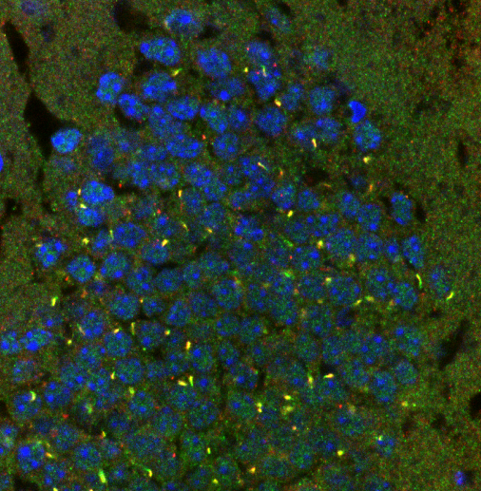

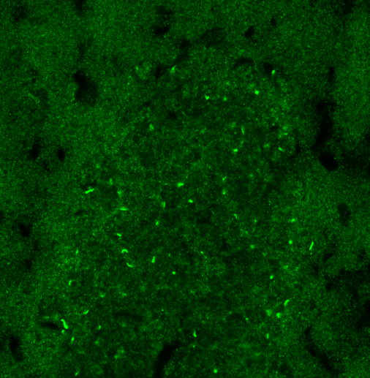

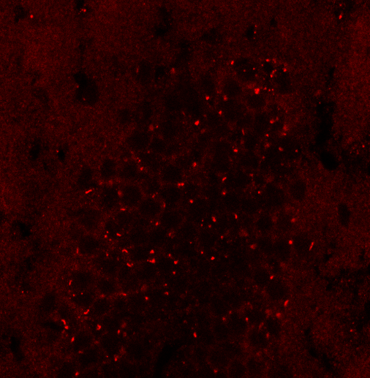
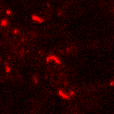
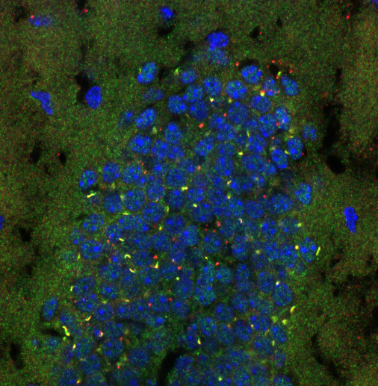

Fig. S2
AC3
AC8
Merge
Pkdl^{+/+}
AC3
AC8
Merge
Pkdl^{-/-}
Supplementary Fig. 2. Confocal images showing AC8 co-localizes with AC3, a known neuronal primary cilium marker, on the neuronal primary cilia in both KO and WT littermate mouse brain tissues. Images were taken in the dentate gyrus of hippocampus. Neurons are identified by neuronal marker NeuN (blue).

Slide 3
Fig. S3
Pkdl^{+/+}
(n = 24)
Pkdl^{-/-}
(n = 48)
Percent of Mice(%)
Severity Score
Supplementary Fig. 3. Pkdl^{-/-} mice are sensitive to PTZ-induced seizure. When challenged with a single injection of PTZ (50 μg/g), KO mice developed more severe seizure in comparison with WT mice (P < 0.003).
Fig. S4
P = 0.023
n = 3
cAMP (pmol/ml)
Pkdl
+/+
-/-
Supplementary Fig. 4. The cAMP levels in young Pkdl^{-/-} mice (5 weeks old) were also reduced significantly (~15% reduction), compared to the WT littermates (P = 0.023).

Slide 4
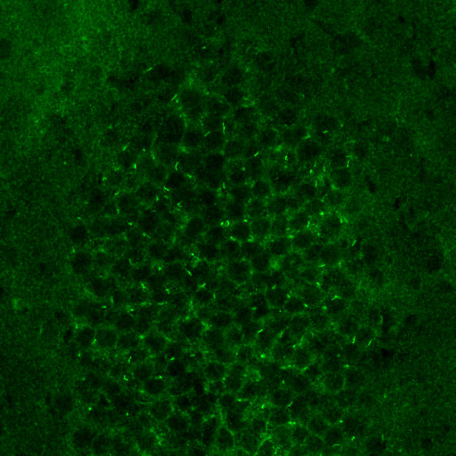
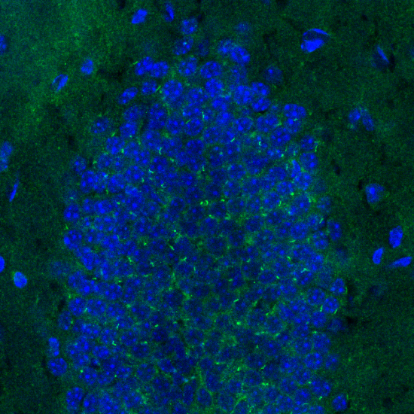
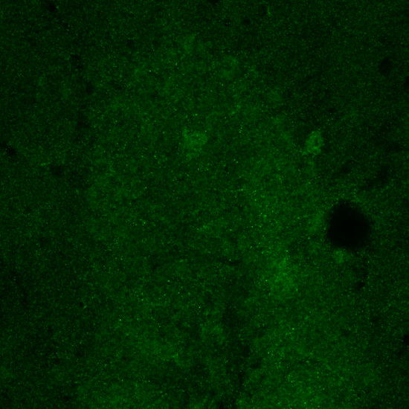
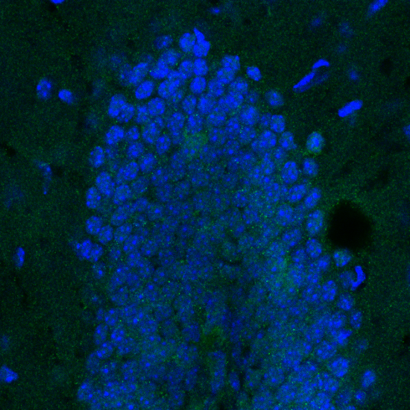
Fig. S5
β2AR
Merge
Control
β2AR
Merge
M50P B.
Supplementary Fig. 5. Pre-incubation of β2AR antibody with immunogen remarkably reduced the neuronal ciliary signal of β2AR in WT mouse brain, which confirmed the specificity of β2AR antibody.

