Slide 1
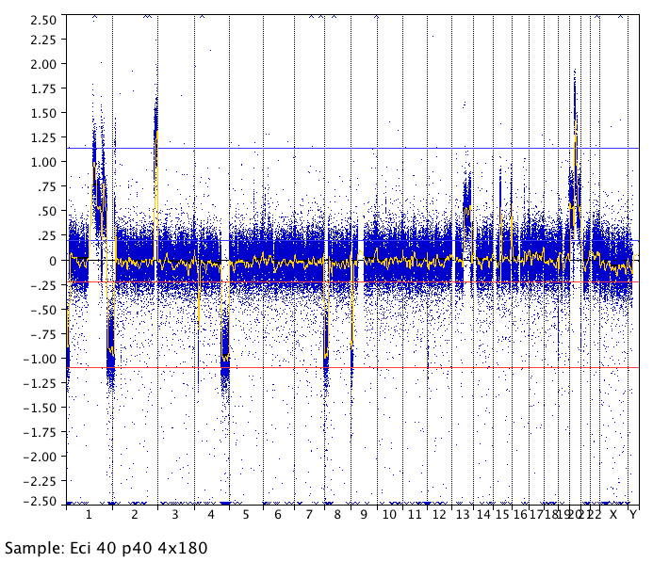
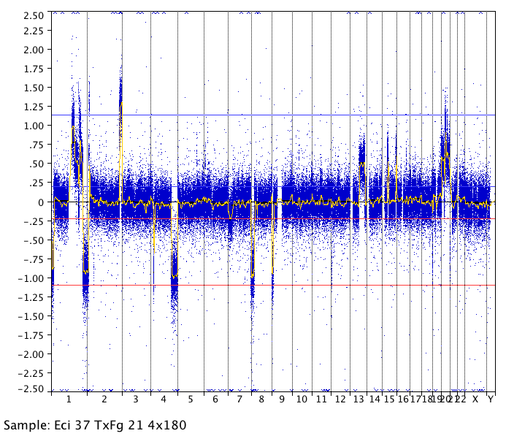
2.5
2.0
1.5
1.0
0.5
0
- 0.5
- 1.0
- 1.5
- 2.0
- 2.5
EndoC-βH2 p40
1
2
3
4
5
6
7
8
9
10
11
12
13
14
15
16
17
18
19
20
21
22
X
Y
2.5
2.0
1.5
1.0
0.5
0
- 0.5
- 1.0
- 1.5
- 2.0
- 2.5
EndoC-βH3 p40
1
2
3
4
5
6
7
8
9
10
11
12
13
14
15
16
17
18
19
20
21
22
X
Y

