Slide 1
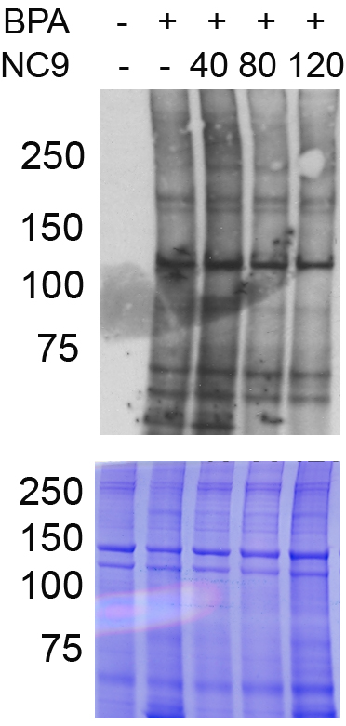
Collagen α1(I)
Collagen α1(I)
Collagen α2(I)
Supplemental Fig. 1: Proteins extracted from SPARC-null jaws incubated with BPA only or BPA with increasing concentrations of the TG inhibitor NC-9 is shown (upper panel). BPA-labeled proteins were detected with avidin-HRP. Equal loading of starting protein is shown by coomassie stain of total protein (lower panel).

