Slide 1
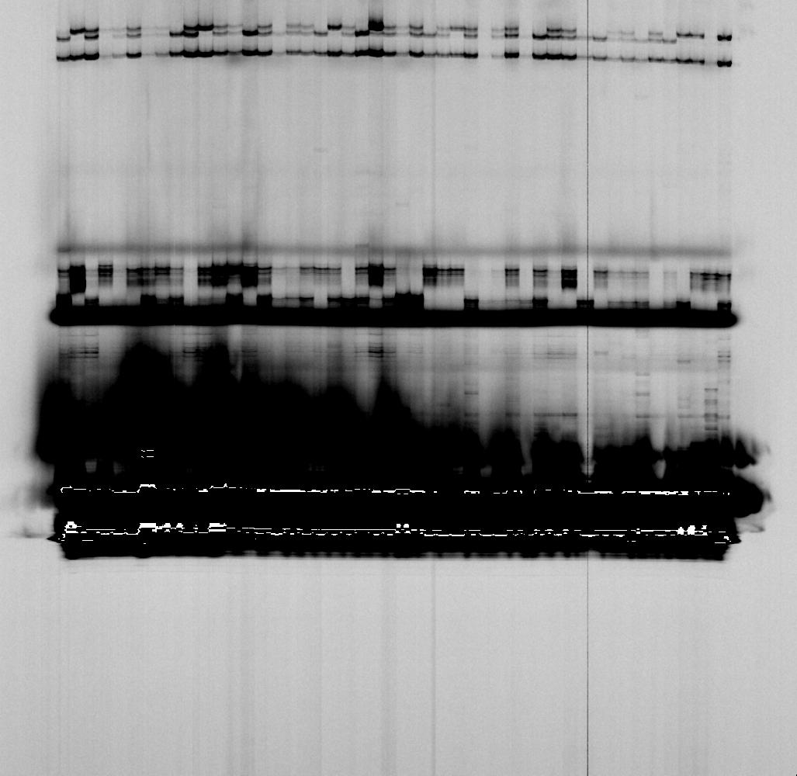
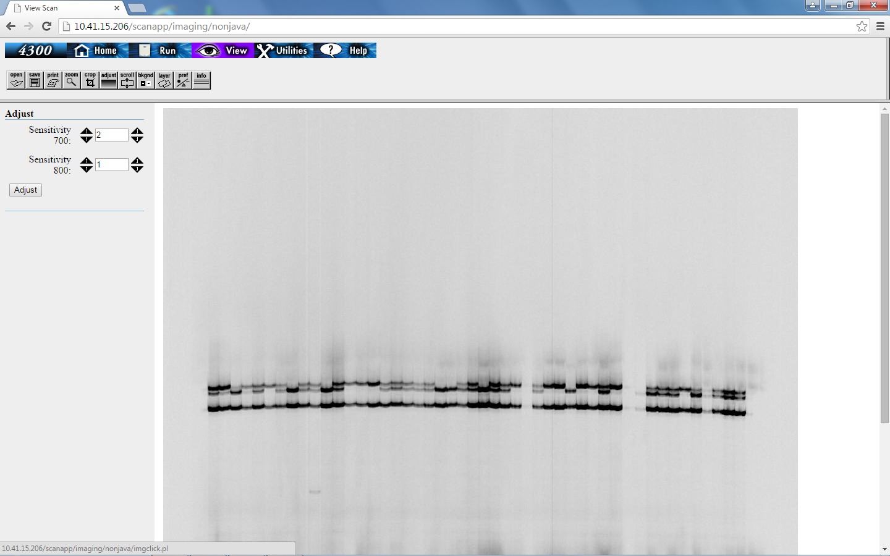
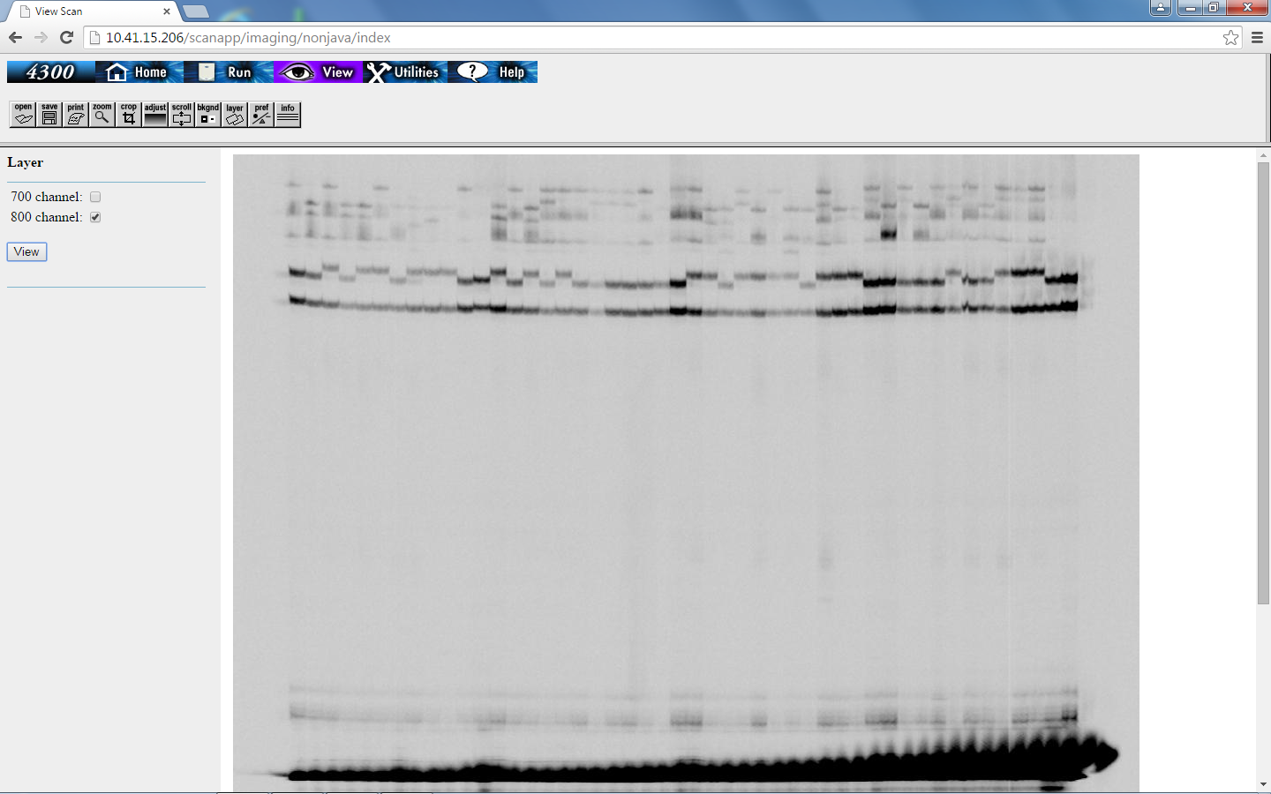
P₁
F₂
F₈
P₂
Figure 2. The gel image of a polymorphism detected between two parents, where P₁ is Yueyou 92 and P₂ is Xinhuixiaoli, in F₂ population and F₈ population using the SSR marker AHGS2236.

