Slide 1
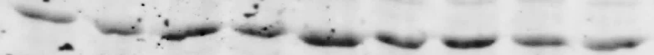
Supplemental Figure I: Representative blots to support Figure 5A
Wistar
GK
LG
HG 1h
HG 4h
LG
HG 1h
HG 4h
AMPK
AMPK
β-actin
β-actin
LG
HG 1h
HG 4h
LG
HG 1h
HG 4h
pAMPK
pAMPK
β-actin
β-actin
LG
HG 1h
HG 4h
LG
HG 1h
HG 4h
peNOS
peNOS
β-actin
β-actin
LG
HG 1h
HG 4h
LG
HG 1h
HG 4h
PGC-1α
PGC-1α
β-actin
β-actin
LG
HG 1h
HG 4h
LG
HG 1h
HG 4h
VDAC1
VDAC1
β-actin
β-actin

Slide 2
Supplemental Figure II: Representative blots to support Figure 5A
Wistar
GK
LG
HG 1h
HG 4h
LG
HG 1h
HG 4h
Complex II
Complex II
Complex V
Complex V
Complex III
Complex III
Complex I
Complex I
Complex IV
Complex IV
β-actin
β-actin

Slide 3
Supplemental Figure III: Representative blots to support Figure 5B
Wistar
GK
LG
HG 1h
HG 4h
LG
HG 1h
HG 4h
MnSOD
MnSOD
β-actin
β-actin
LG
HG 1h
HG 4h
LG
HG 1h
HG 4h
UCP3
UCP3
β-actin
β-actin

Slide 4
Supplemental Figure IV: Representative blots to support Figure 5D
Wistar
GK
LG
HG 1h
HG 4h
LG
HG 1h
HG 4h
Mfn1
Mfn1
β-actin
β-actin
LG
HG 1h
HG 4h
LG
HG 1h
HG 4h
Mfn2
Mfn2
β-actin
β-actin
LG
HG 1h
HG 4h
LG
HG 1h
HG 4h
OPA1
OPA1
β-actin
β-actin

Slide 5
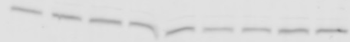

Supplemental Figure V: Representative blots to support Figure 5D
Wistar
GK
LG
HG 1h
HG 4h
LG
HG 1h
HG 4h
Beclin
Beclin
β-actin
β-actin
LG
HG 1h
HG 4h
LG
HG 1h
HG 4h
p62
p62
β-actin
β-actin
LG
HG 1h
HG 4h
LG
HG 1h
HG 4h
LC3-I
LC3-I
LC3-II
LC3-II
β-actin
β-actin
LG
HG 1h
HG 4h
LG
HG 1h
HG 4h
Atg7
Atg7
β-actin
β-actin

