Slide 1
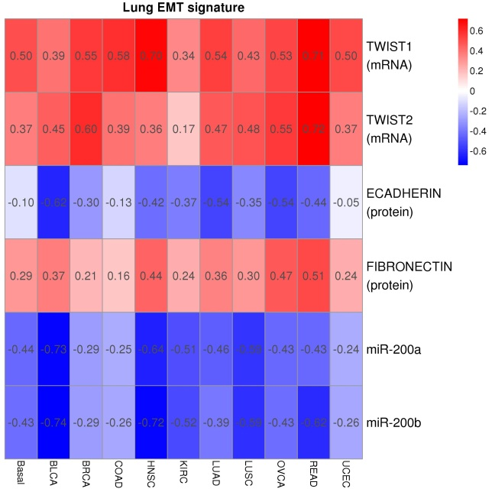
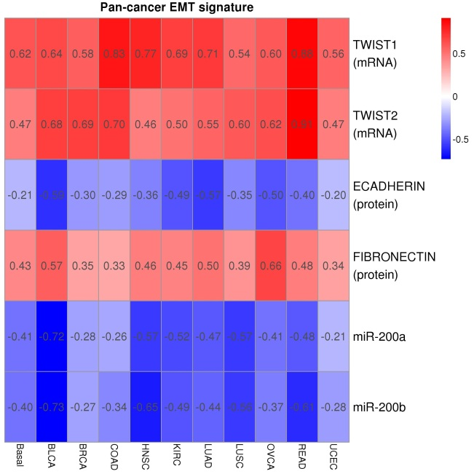
Supplemental figure S1.
A
Symbol | Status | Correlation | Seeds | meta | Identified With
CDH1 | E | 1.000 | CDH1 | CDH1:1:E | CDH1
CLDN4 | E | 0.377 | CDH1 | CDH1:0.377:E | CDH1
GPR56 | E | 0.401 | CDH1 | CDH1:0.401:E | CDH1
GRHL2 | E | 0.404 | CDH1 | CDH1:0.404:E | CDH1
PRSS8 | E | 0.399 | CDH1 | CDH1:0.399:E | CDH1
ESRP1 | E | 0.448 | CDH1 | CDH1:0.448:E | CDH1
ERBB3 | E | 0.404 | CDH1 | CDH1:0.404:E | CDH1
GALNT3 | E | 0.384 | CDH1 | CDH1:0.384:E | CDH1
F11R | E | 0.408 | CDH1 | CDH1:0.408:E | CDH1
CDS1 | E | 0.414 | CDH1 | CDH1:0.414:E | CDH1
FN1 | M | 1.000 | CDH2;FN1 | CDH2:0.483:M;FN1:1:M | FN1
MMP2 | M | 0.647 | CDH2;VIM | CDH2:0.46:M;VIM:0.647:M | VIM
AXL | M | 0.604 | VIM | VIM:0.604:M | VIM
VIM | M | 1.000 | VIM | VIM:1:M | VIM
B

Slide 2
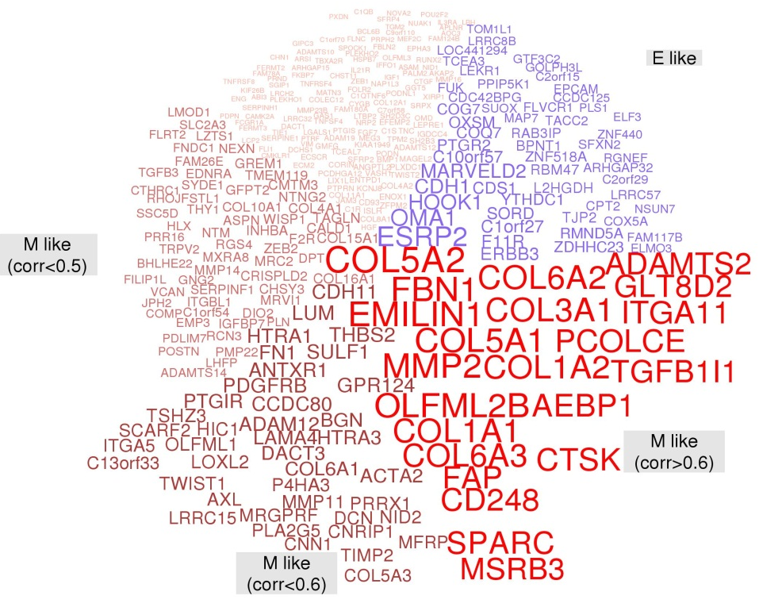

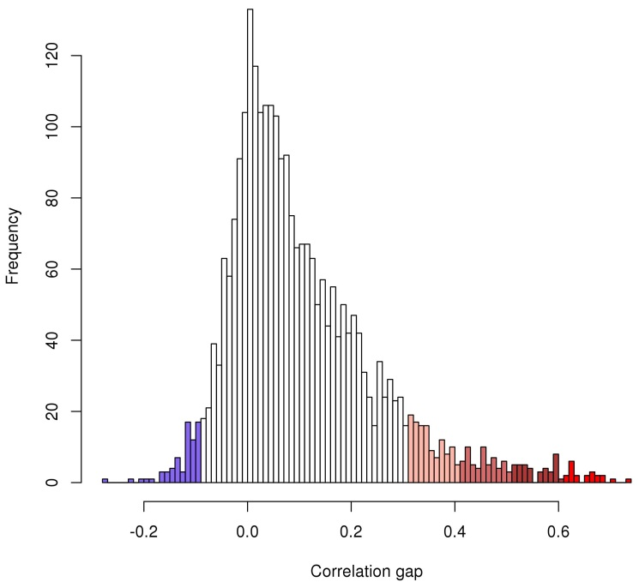
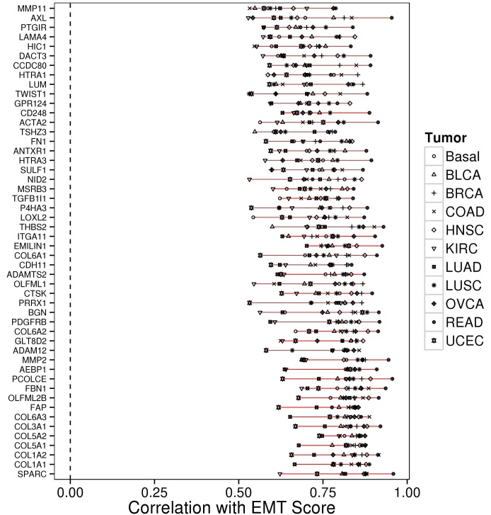
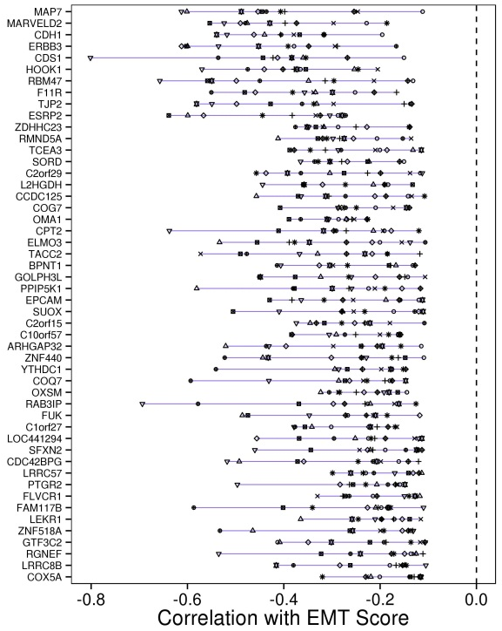
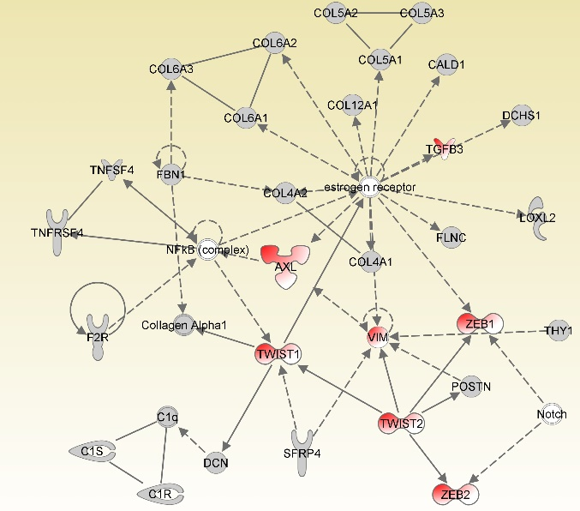
Supplemental figure S2.
A
B
C
D

