Slide 1
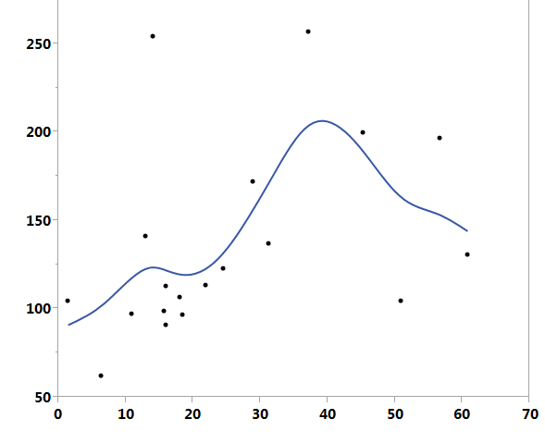
A
B
*
Relative % γ-globin/Cyclophilin A mRNA
Relative % α-globin/Cyclophlin A mRNA
Scr shRNA
KLF1 shRNA
Relative % KLF1/Cyclophilin A mRNA

