Slide 1
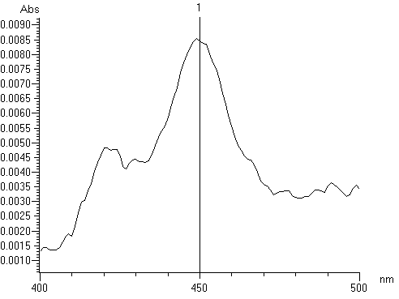
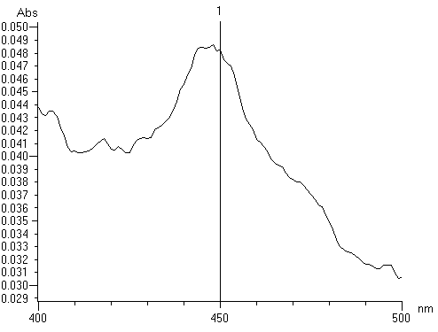
A
GS-IAN ICHO IAOx IAN
C
mV
B
ICHO IAN
CYP71A12 + IAOx + NADPH
CYP71A12 + IAN + NADPH
CYP71A12 + IAN - NADPH
CYP71A12 + IAOx – NADPH
Vector + IAN + NADPH
Vector + IAOx + NADPH
D
E
Supplemental Figure 1: Enzymatic properties of CYP71A12 and CYP71A13. A-C: overlay of chromatograms. A: Turnover of IAOx and GSH (278 nm); B: IAN turnover (278 nm); C: cyanide formation with IAOx/IAN as substrate (emission 460 nm with excitation at 418 nm); D/E: CO spectra of yeast microsomes expressing (D) CYP71A12, 2 mg ml⁻¹, or (E) CYP71A13, 3 mg ml⁻¹ microsomal protein

