Slide 1
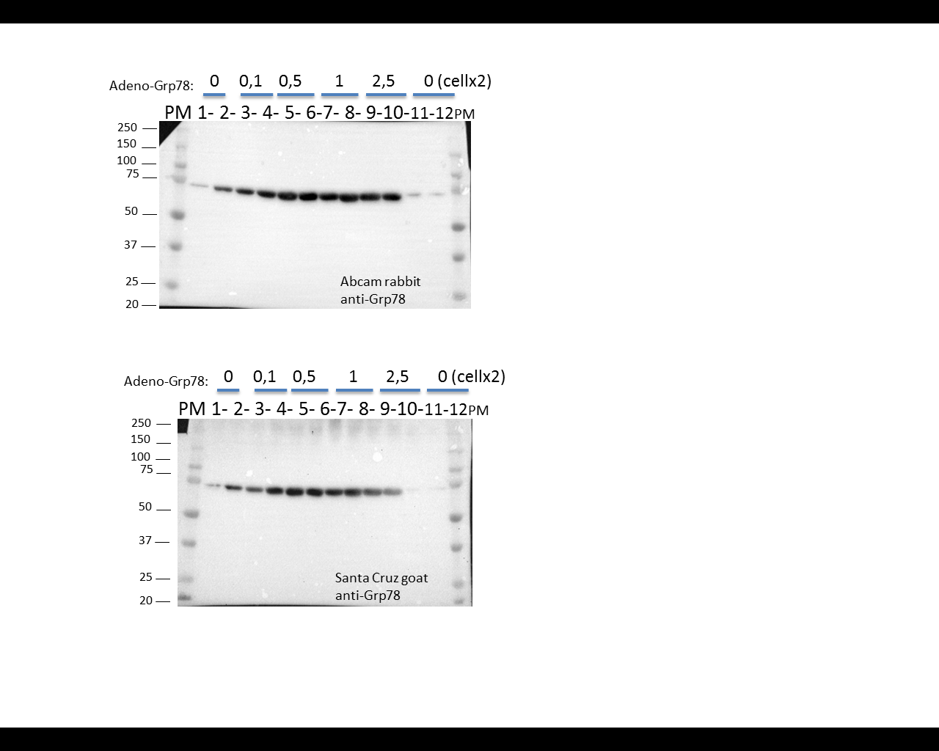
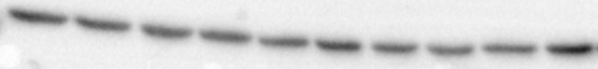
S7 Fig.
Grp78-Ad(μL)
0
0.1
0.5
1
2.5
Grp78
0,5
78 kDa
Tubulin
50 kDa
***
**
**
*
GRP78/Tubulin (% control)
Grp78-Ad(μL)

