Slide 1
In slide show mode - use the page down key to move through the slides and view the video clips.
ACCOMMODATIVE MOVEMENTS OF THE LENS/CAPSULE AND THE PVZ INS-LE IN RELATION TO THE VITREOUS FACE AND AGING
MARY ANN CROFT¹, GREGG HEATLEY¹, JARED P. MCDONALD¹, ALEXANDER KATZ¹, AND PAUL L. KAUFMAN^{1, 2, 3}
¹Department of Ophthalmology and Visual Sciences, University of Wisconsin-Madison, Madison, WI 53792; ²Wisconsin National Primate Research Center; ³McPherson Eye Research Institute

Slide 2
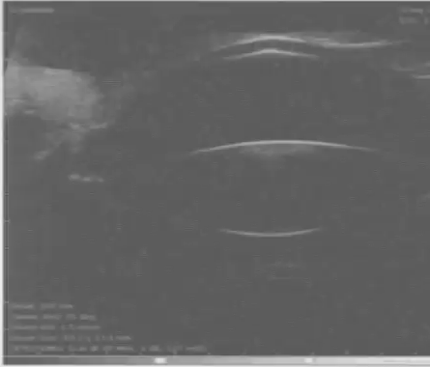
cornea
anterior lens surface
posterior lens surface
Video clip 1. UBM images in the young phakic rhesus monkey eye (age 7); the posterior lens pole moves posteriorly during accommodation as in the human eye.

Slide 3
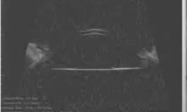
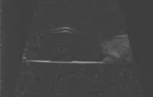
Young Monkey (age 9)
Older Monkey (age 17)
cornea
cornea
capsule
capsule
Video clips 2 (left panel), and 3 (right panel). UBM images in young and older rhesus monkey eyes two weeks following ECLE. The central capsule bows backward during accommodation and the backward bowing is less pronounced in the older eye.

Slide 4
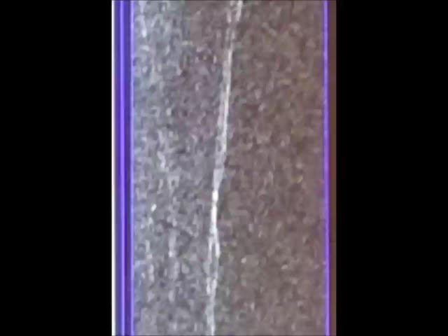
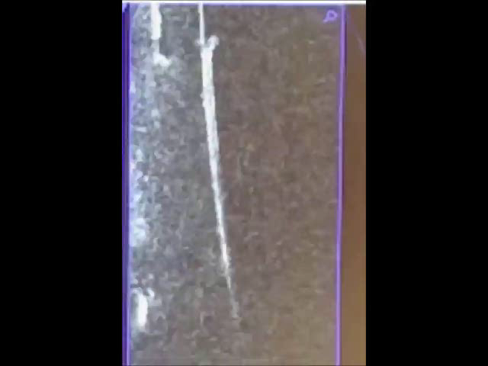
posterior
anterior
posterior
anterior
capsule
capsule
Video clips 4 (left panel) and 5 (right panel). Heidelberg Spectralis OCT images collected in a rhesus monkey eye (age 17) two weeks after ECLE. The monkey was in a prone position (facing forward). The video clips show that the capsule also bows backward if the monkey is in a prone position. The OCT instrument was provided courtesy of Steve Eastman, Cedarburg WI.

Slide 5
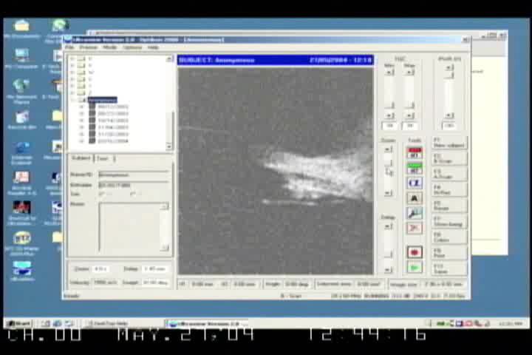
PVZ INS-LE
Video clip #6. UBM image in a young rhesus monkey eye (aged 13) showing that the PVZ INS-LE moves forward in the absence of the lens/capsule.
Notes:
AP85

