Slide 1
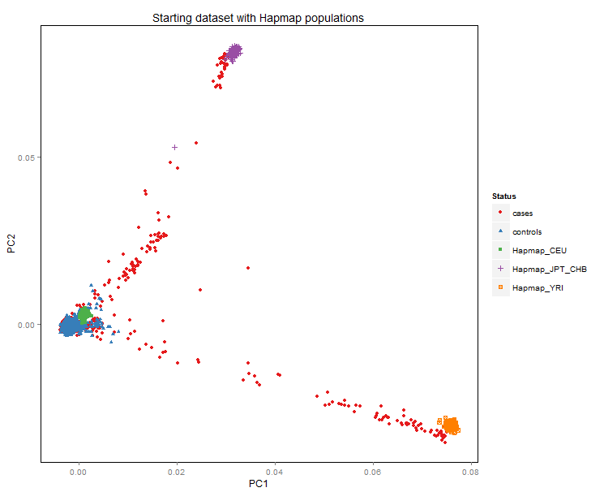
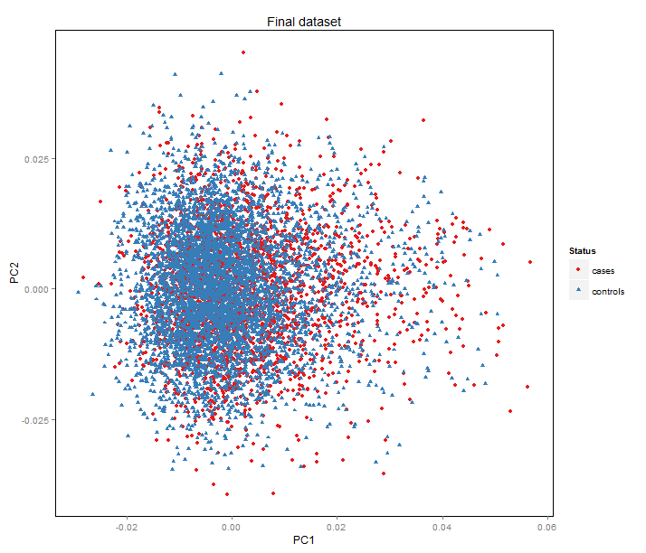
Additional File 4: Results of principal components analysis (PCA) – ICICLE cohort
A
B
A: PCA with the 3 HapMap populations
B: PCA after exclusion of outliers (327 cases and 164 controls).

