Slide 1
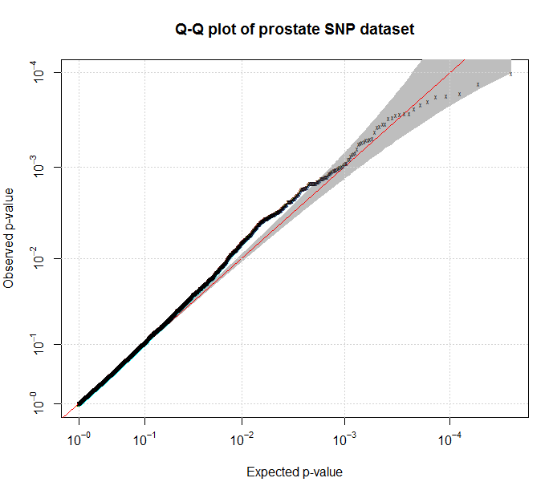
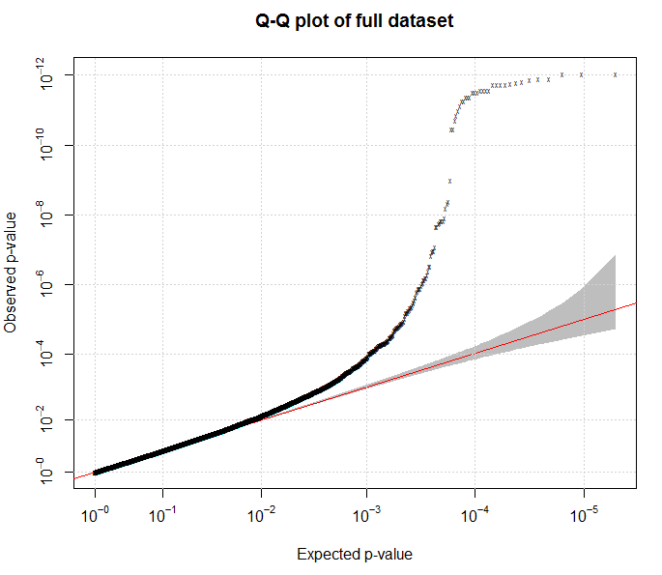
Additional File 5: Quantile-quantile plot for ICICLE
A
B
A: QQ plot based on the 37,289 uncorrelated SNPs not selected on the basis of breast cancer risk (λ=1.065).
B:QQ plot for all SNPs in dataset (λ=1.092).

