Slide 1
Supplementary Figure 1. Metabolomic profiles in the neural tube of E10.5 mouse embryos. Volcano plots of UPLC-QTOF-MS assay of metabolome, comparing between diabetic and non-diabetic groups. (A) Positive ESI mode. (B) Negative ESI mode. (X-axis) Log 2 (fold change). (Y-axis) -Log 10 (p-value). The pink dots represent metabolites with p-value < 0.05 and fold change ≥ 2. n = 6.

Slide 2
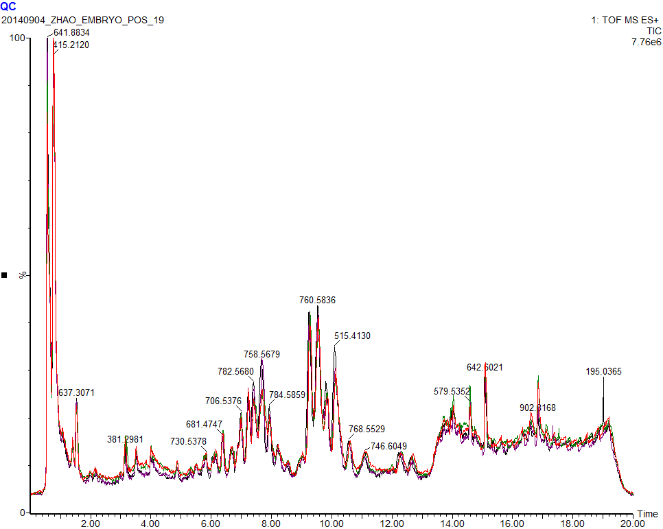
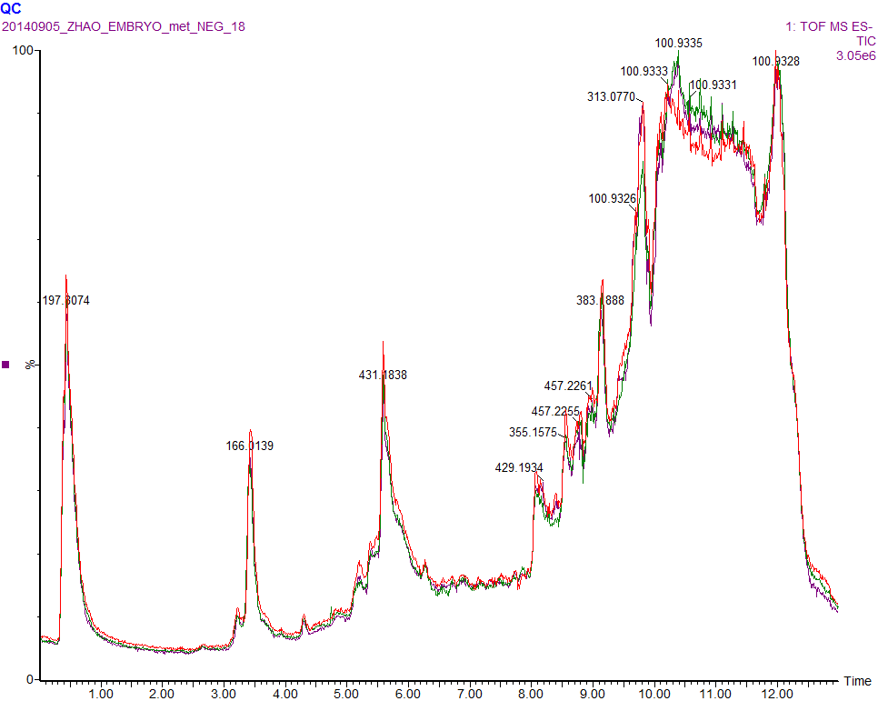
A
B
Supplementary Figure 2. Total ion chromatogram overlay of pooled quality control injections that were interspersed throughout the UPLC-QTOF-MS batch acquisition in electrospray positive (A) and negative (B) modes.

