Slide 1
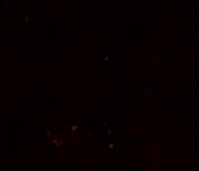
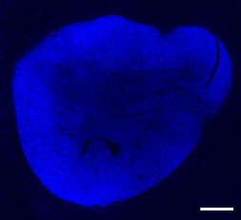
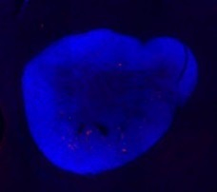
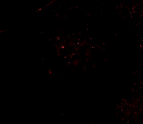
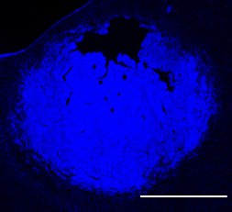
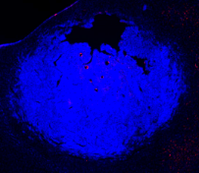
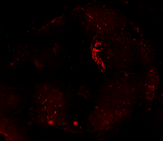
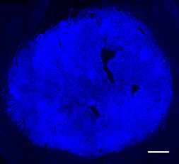
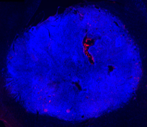
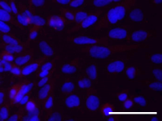
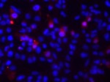
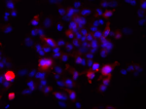
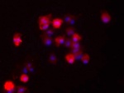
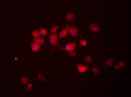
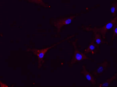
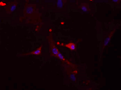
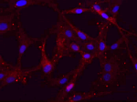
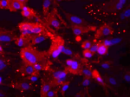
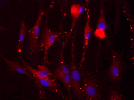
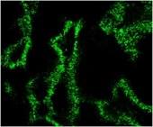
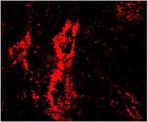
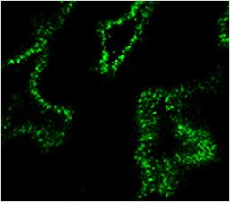
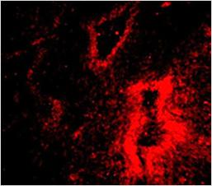
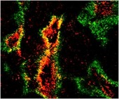
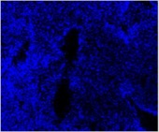
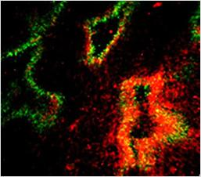
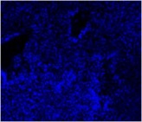
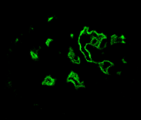

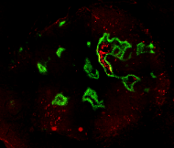
Figure S1
A
SDF-1
Hoechst
Merged
U87
Pre-hypoxic U251
Hypoxic U251
B
24h in 20% O₂
24h in 1% O₂
48h in 1% O₂
24h in 0.2% O₂
48h in 0.2% O₂
U251
SDF-1
U87
Hoechst
C
Hypoxic U251
CD68
CD14
PIMO
PIMO
Hoechst
Hoechst
D
Hypoxic U251
SDF-1
PIMO
Hoechst

Slide 2
Figure S2
NS
*
IFN-γ and IL4 mRNA relative expressions compared to U87 and U251 in normoxia
NS
NS
NS
*
U87
IFN-γ
U251
U87
IL4
U251
20% O₂
1% O₂
0.2% O₂

Slide 3
Figure S3
A
NS
*
*
*
*
*
*
NS
*
NS
iNOS mRNA relative expression compared to M0 MΦ in normoxia
NS
NS
Arg1 mRNA relative expression compared to M0 MΦ in normoxia
NS
.
.
M1
M2
M0
M1
M2
M0
M0
M1
M2
M0
M1
M2
M0
M1
M2
M0
M0
M1
M2
M0
15h
24h
72h
15h
24h
72h
B
*
*
*
*
*
*
*
*
NO concentration (µM)
Arg1 activity (µg urea/h)
NS
NS
*
NS
NS
NS
M1
M2
M0
M1
M2
M0
M0
M1
M2
M1
M2
M0
M1
M2
M0
M0
M1
M2
M0
M0
15h
24h
72h
15h
24h
72h
20% O₂
1% O₂
0.2% O₂

Slide 4
Figure S4
*
*
A
*
*
*
*
*
*
NS
NS
NS
NS
*
NS
*
NS
NS
NS
NS
NS
NS
*
Arg1 mRNA relative expression compared to M0 MΦ in normoxia
NS
iNOS mRNA relative expression compared to M0 MΦ in normoxia
NS
NS
M1
M2
M1
M2
M1
M2
M1
M2
M1
M2
M1
M2
15h
24h
72h
15h
24h
72h
*
B
*
*
*
*
*
NS
*
NS
NS
*
*
NS
NO concentration (µM)
*
Arg1 activity (µg urea/h)
NS
*
*
*
NS
NS
*
NS
*
NS
M1
M2
M1
M2
M1
M2
M1
M2
M1
M2
M1
M2
15h
24h
72h
15h
24h
72h
20% O₂
1% O₂
0.2% O₂

Slide 5
Figure S5
A
*
*
*
NS
NS
NO concentration (µM)
Arg1 activity (µg urea/h)
NS
NS
M0
M1
M2
M0
1% O₂
M0
0.2% O₂
M0
M1
M2
M0
1% O₂
M0
0.2% O₂
20% O₂
20% O₂
B
NS
NS
NS
NO concentration (µM)
NS
Arg1 activity (µg urea/h)
NS
NS
NS
NS
20% O₂
1% O₂
0.2% O₂
20% O₂
1% O₂
0.2% O₂
1% O₂
0.2% O₂
1% O₂
0.2% O₂
M1
M2
20% O₂
M1
20% O₂
M2
control
Re-oxygenation

