Slide 1
A
B
Supplementary Figure 1. The effect of 10 μM cannabidiol (CBD) applied after
4 hours OGD on BBB permeability from all experiments (n=45) presented as a time course (A) and as the area under the curve of the whole experiment (B). Data are given as mean ± S.E.M. Statistical analysis conducted using two-way ANOVA (A) or Student's t-test (B). *** P<0.001, **** P<0.0001.

Slide 2
Supplementary Figure 2. Cytokine/chemokine levels in the abluminal medium of BBB co-culture inserts at 32 hours for IFNγ, IL-10, IL-1β, IL-2, IL-6, CCL3 (MIP-1α), CCL4 (MIP-1β), TNF-α and VEGF. Data are given as mean ± S.E.M. Statistical analysis conducted using one-way ANOVA with post hoc analysis of selected pairs (vehicle versus CBD).

Slide 3
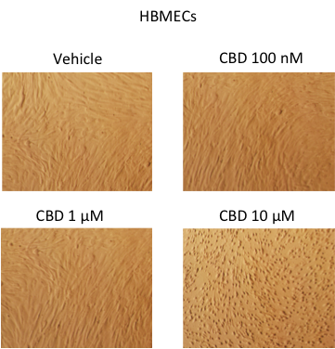
Vehicle
CBD 100 nM
CBD 1 µM
CBD 10 µM
Supplementary Figure 3. The effect of 28h treatment with increasing concentrations of cannabidiol (CBD) on HBMEC cell morphology. At the highest concentration, CBD appeared to cause cell damage, which was associated with a significant decrease in protein levels and significant increase in LDH release (see Figure 5).

Slide 4
Supplementary Figure 4. No differences were observed after CBD treatment in the levels of phosphorylated JNK (A), ERK (B), Akt (c), NFκB (D), p70s6K (E), STAT3 (F) or STAT5 (G) in HBMECs treated for 28 h with CBD. Data are given as mean ± S.E.M. Statistical analysis conducted using one-way ANOVA with Dunnett’s post hoc test

Slide 5
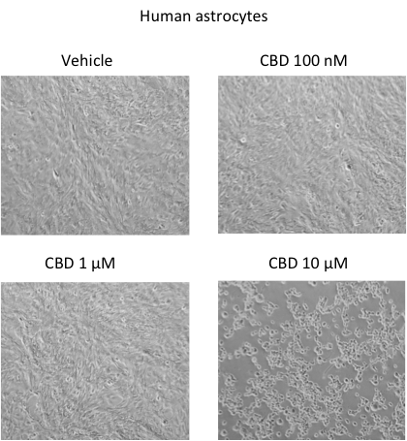
A
Vehicle
CBD 100 nM
CBD 1 µM
CBD 10 µM
B
C
D
E
Supplementary Figure 5. A. Light microscope images of human brain astrocytes treated by vehicle or increasing concentrations of CBD for 28 h in normal conditions. At the highest concentration, CBD appeared to cause cell damage, which was associated with a significant decrease in protein levels (B) and significant increase in LDH release (C). The levels of IL-6 (D) and VCAM (E) in medium from astrocyte monocultures treated for 28 h with CBD. All data was normalised to total protein (BCA assay). Data are given as mean ± S.E.M. Statistical analysis conducted using one-way ANOVA with Dunnett’s post hoc test, n = 3-6, ** P<0.01, *** P<0.001.

