Slide 1

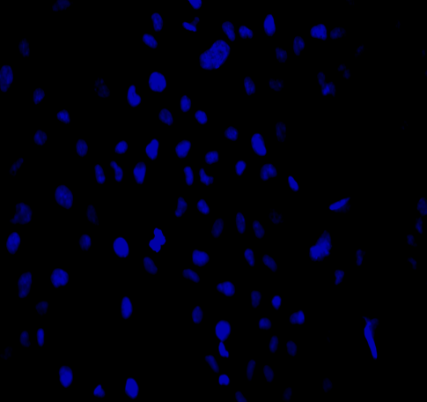
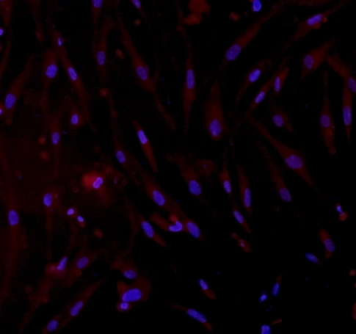
Supplemental figure S4
A
B
LM-MEL-59
LM-MEL-44
TKTL1
64kDa
TKTL1
64kDa
GAPDH
37 kDa
GAPDH
37kDa
Control
siRNA
TKTL1
siRNA
Empty
vector
TKTL1 pcDNA
C
LM-MEL-44
TKTL1 (red) and DAPI (blue)
Empty
vector
TKTL1 pcDNA

