Slide 1
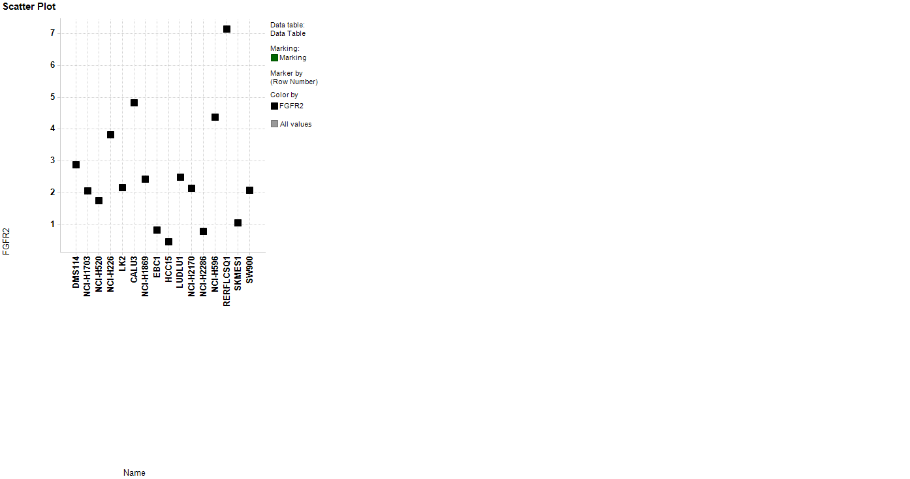
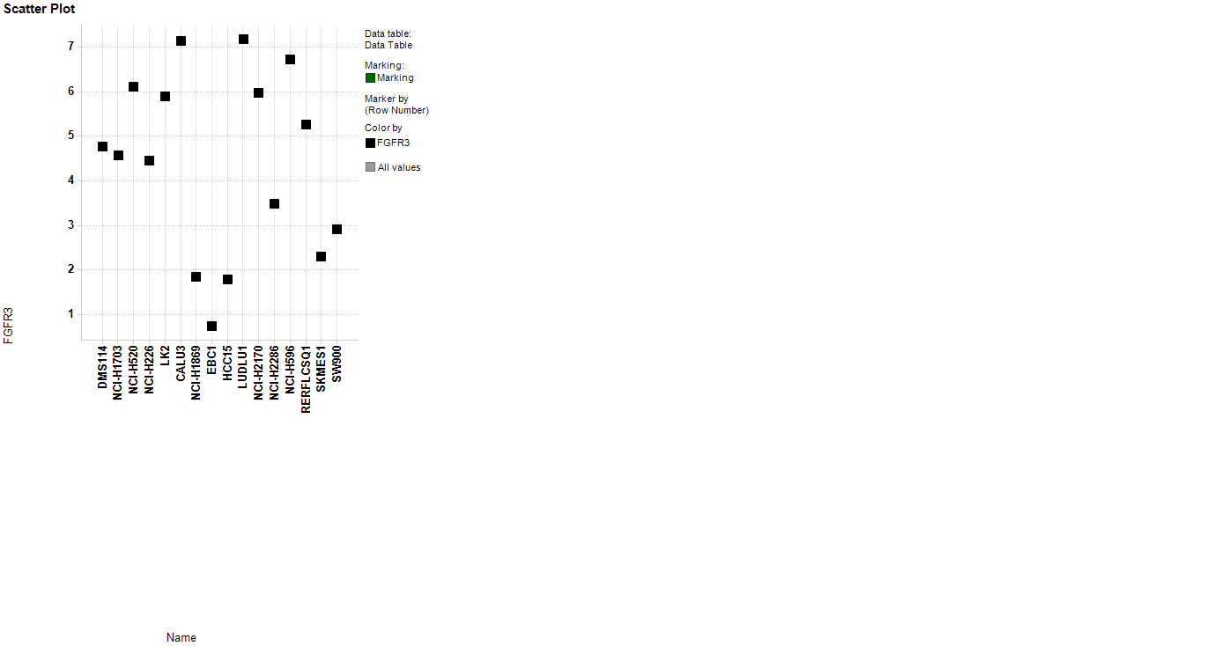
S2 Fig.
FGFR2 mRNA (normalised log₂ counts)
FGFR3 mRNA (normalised log₂ counts)
Sensitive
Resistant
Sensitive
Resistant

