Slide 1
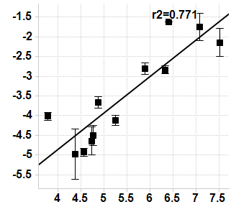
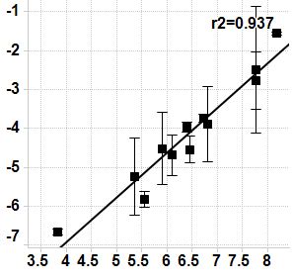
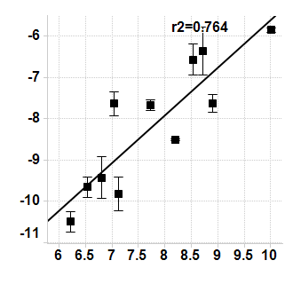
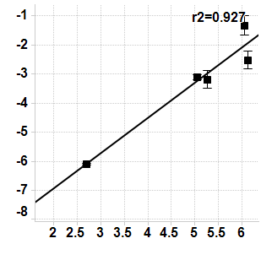
S3 Fig.
FGFR1
FGFR2
Taqman
Taqman
Nanostring
Nanostring
FGFR3
FGF-2
Taqman
Taqman
Nanostring
Nanostring

