Slide 1
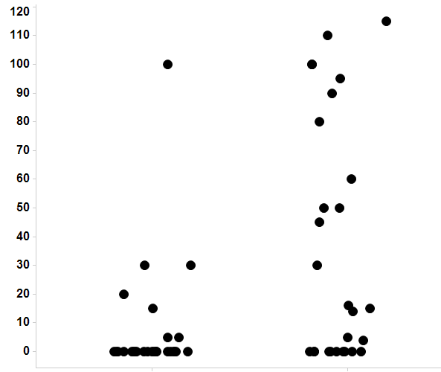
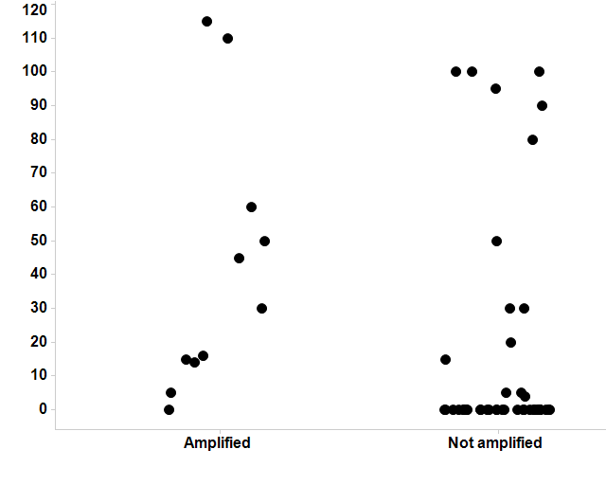
S4 Fig.
p=0.002
A
FGFR1 H-score
<mean
>mean
FGFR1 mRNA
B
p=0.03
FGFR1 H-Score

