Slide 1
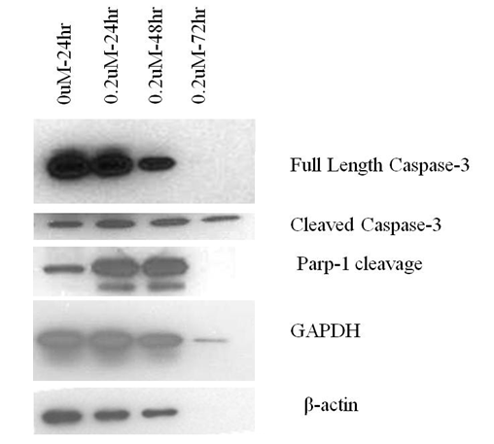
A
B
C
D
E
Additional Figure 6.

