Slide 1
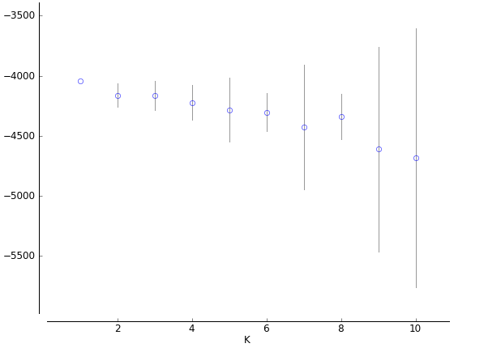
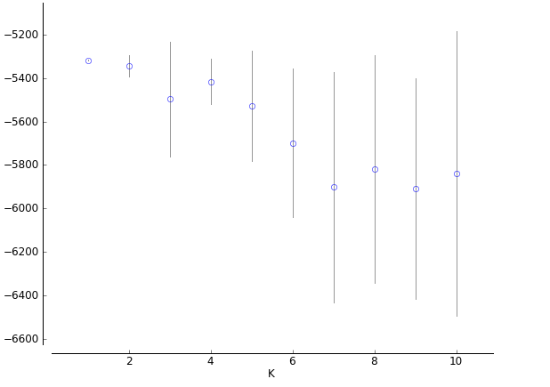
ln (posterior probabilities of data)
ln (posterior probabilities of data)
2011/2012
2012/2013
Supplementary Figure 1. Mean posterior probabilities (+/- SD) of genotype data from 18 microsatellite markers given K subpopulations for a great tit population sampled during two field seasons. The mean probabilities were calculated using Structure with default settings (admixture model with correlated allele frequencies) from 20 replicated runs.

