Slide 1
Beaudin and Welsh, Figure 1
A
B
Notes:
Triplicates GLUL and SLC1A1 time course 2-12 modified 1/9/15
Triplicates 6.2.15 isoforms

Slide 2
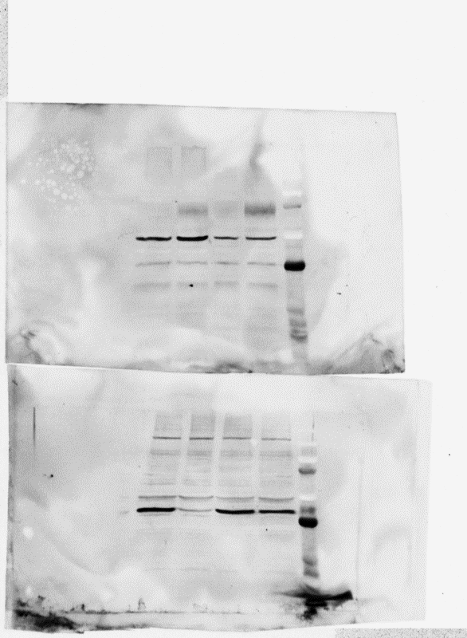
Beaudin and Welsh, Figure 2
A
CON
1,25D
EAAT3
GAPDH
B
Notes:
7/23/15
10/5/12
10/24/12

Slide 3
Beaudin and Welsh, Figure 3
A
B
C
Notes:
8/26/11 3 wells

Slide 4
Beaudin and Welsh, Figure 4
A
B
Notes:
Top 8/26/11 – excel sheets
Bottom 8/27/15
Cell density (absorbance)

Slide 5
Beaudin and Welsh, Figure 5
Notes:
Triplicates 3/30/15

Slide 6
Beaudin and Welsh, Figure 6
A
B
C
Notes:
7/30/15 3 dishes
7/11/14 3 dishes

Slide 7
Beaudin and Welsh, Figure 7
Notes:
Triplicates modified 2/13/15
G6PD - This gene encodes glucose-6-phosphate dehydrogenase. This protein is a cytosolic enzyme encoded by a housekeeping
X-linked gene whose main function is to produce NADPH, a key electron donor in the defense against oxidizing
agents and in reductive biosynthetic reactions.
PGD - Catalyzes the oxidative decarboxylation of 6-phosphogluconate to ribulose 5-phosphate and CO(2), with
concomitant reduction of NADP to NADPH.
IDH2 - Isocitrate dehydrogenases catalyze the oxidative decarboxylation of isocitrate to 2-oxoglutarate. These enzymes
belong to two distinct subclasses, one of which utilizes NAD(+) as the electron acceptor and the other NADP(+).
GCLC - Glutamate-cysteine ligase, also known as gamma-glutamylcysteine synthetase is the first rate-limiting enzyme of
glutathione synthesis.
IDH2 acts in the forward Krebs cycle as an NADP⁺-consuming enzyme, providing NADPH for maintenance of the reduced glutathione
Add PRODH

Slide 8
Beaudin and Welsh, Figure 8
25D
Glutamate
1,25D
SLC1A1
SLC1A2
SLC1A6
1,25D
SLC7A11
VDR
Glutamate
GCLC
GSH
G6PD
NADPH
PGD
IDH2

Slide 9
Supplemental Table 1. Primer Sequences used for real time PCR.
Gene | Primer Sequence
SLC1A1 | Fwd: CGAAAGAACCCTTTCCGATTTGC Rev: GAAGGTGACAGGCAGTGTTGCT
SLC1A1 P1 | Fwd: GCTGTCGACTGGCTCCTG Rev: GGAGAGCTTTTCCACAATGC
SLC1A1 P2 | Fwd: ACTGCCTTTTATGTCTCCAACAGG Rev: TCATGTTCATCTCTGGATCGCTGG
SLC1A1 ex2skip | Fwd: AGCGCTTCCTGAAGAATAACTGGG Rev: GAATCCAGTGCAGCAACACCTAGC
SLC1A1 ex11skip | Fwd: TTGGGCAGATCATCACCATCAGGG Rev: AATGCCCGTCCCAAAAGCATCACC
G6PD | Fwd: CTGTTCCGTGAGGACCAGATCT Rev: TGAAGGTGAGGATAACGCAGGC
PGD | Fwd: GTTCCAAGACACCGATGGCAAAC Rev: CACCGAGCAAAGACAGCTTCTC
IDH2 | Fwd: AGATGGCAGTGGTGTCAAGGAG Rev: CTGGATGGCATACTGGAAGCAG
GCLC | Fwd: GGAAGTGGATGTGGACACCAGA Rev: GCTTGTAGTCAGGATGGTTTGCG
SLC1A2 | Fwd: TGCCAACAGAGGACATCAGCCT Rev: CAGCTCAGACTTGGAGAGGTGA
SLC1A3 | Fwd: GGTTGCTGCAAGCACTCATCAC Rev: CACGCCATTGTTCTCTTCCAGG
SLC1A6 | Fwd: AACACAAGGGCAGAGTCCTCAG Rev: CCAGCAATCAGGAACAGGATGC
SLC1A7 | Fwd: CAGTGCCTCAATGAGTCGGTCA Rev: CTCCAGGATCTTACCCGCAATG
SLC7A11 | Fwd: TCCTGCTTTGGCTCCATGAACG Rev: AGAGGAGTGTGCTTGCGGACAT

Slide 10
Supplemental Fig 1. Effect of 25-hydroxyvitamin D3 on SLC1A1 expression in hTERT-HME1 cells. Cells were treated with 100nM 25-hydroxyvitamin D3 or vehicle for 24h. SLC1A1 mRNA expression was analyzed by qPCR, normalized to 18S and expressed relative to control values which were set at 1. Data are mean ± SD of triplicates.
Notes:
Triplicates 6/2/11

