Slide 1
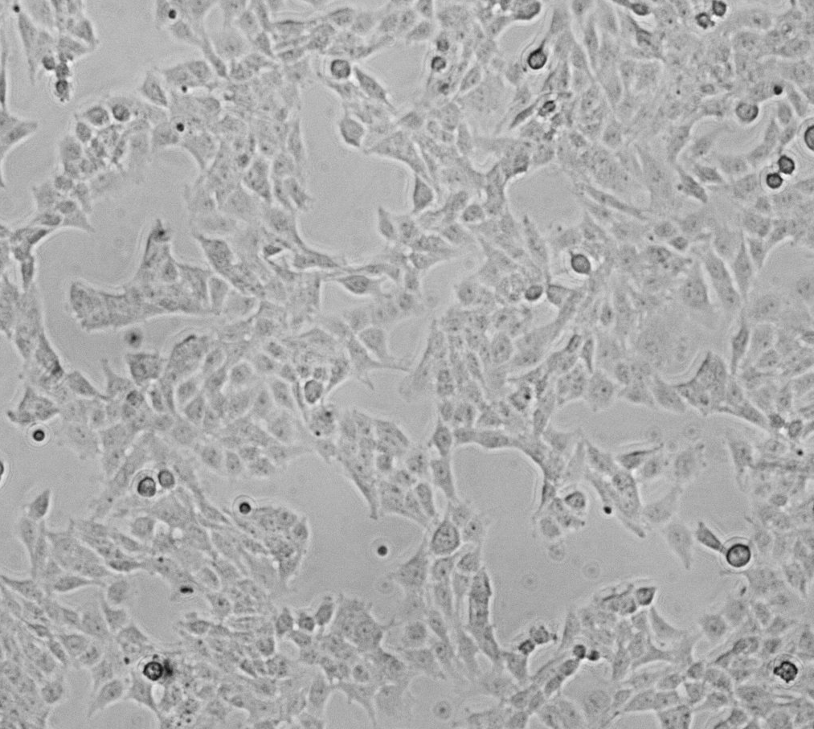
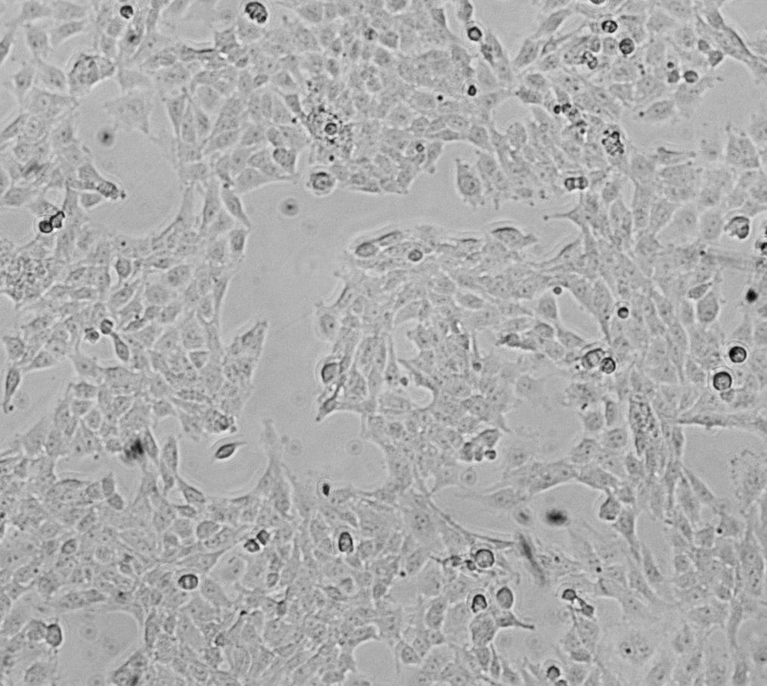
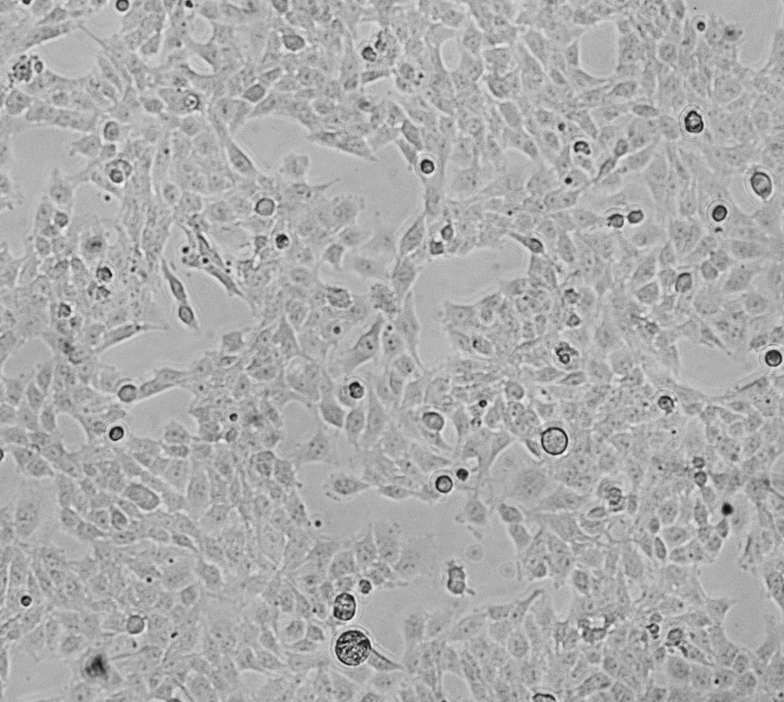
A
Supplemental Figure S6
U251-T2 Glioma Cells
sTNFα [1000 pg/mL]
sTNFα [5000 pg/mL]
***
***
B
C
***
***
***
***
Notes:
Experiment MTT from 3-29-14 cytotox assay; PICs from 7-2-14 studies 10x at 12 hours; PICS Taken from 7-2-14 TNF Alone at 12 hours

