Slide 1
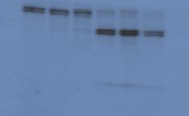
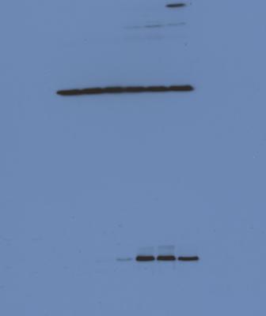
Supplemental Figure S7
Glioma +OV + 2000 pg./mL TNFα
Glioma +OV + 1000 pg/mL TNFα
Glioma + 2000 pg/mL TNF-α
Glioma + Microglia +OV
Glioma
Glioma +OV
1
2
Caspase-8
3
Cleaved PARP
GAPDH
Notes:
6-23-14. 25ug/ protein. 1= full length caspase 8, 2= cleaved intermediate caspase-8 p43/41, 3=cleaved active fragment of caspase 8 p18;

