Slide 1
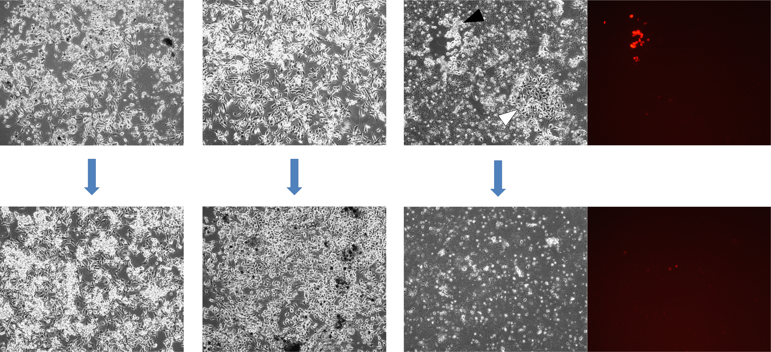
Supplementary Figure 6
PBS-injected tumor
Ad5/3Δ24-injected tumor
VV-injected tumor
Day 3 post explant
Cells split
Day 9 post explant
infected
uninfected

