Slide 1
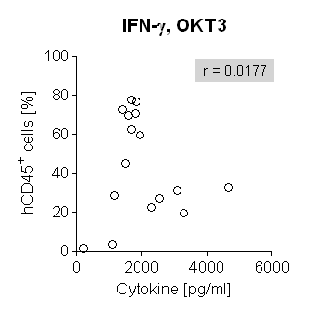
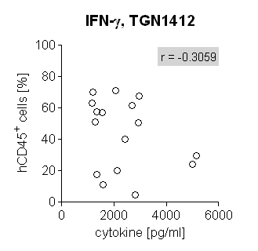
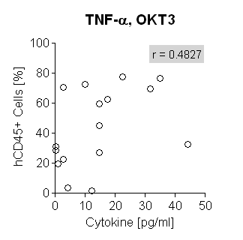
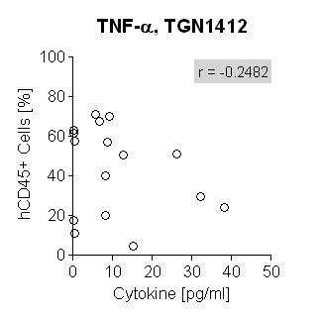
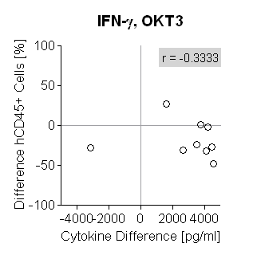
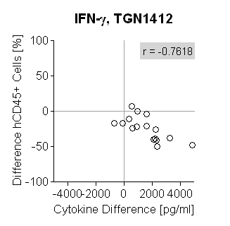
S3 Fig
A
100
IFN-γ, OKT3
100
IFN-γ, TGN1412
80
r=0.0177
80
r=-0.3059
60
60
hCD45⁺ cells [%]
40
40
20
20
0
2000
4000
6000
0
2000
4000
6000
cytokine [pg/ml]
cytokine [pg/ml]
100
TNF-α, OKT3
100
TNF-α, TGN1412
80
r=0.4827
80
r=-0.2482
60
60
hCD45⁺ cells [%]
40
40
20
20
0
10
20
30
40
50
0
10
20
30
40
50
cytokine [pg/ml]
cytokine [pg/ml]
B
100
IFN-γ, OKT3
100
IFN-γ, TGN1412
r=-0.333
r=-0.7618
50
50
0
0
differences hCD45⁺ cells [%]
-50
-50
-100
-4000
-2000
0
2000
4000
-100
-4000
-2000
0
2000
4000
cytokine differences [pg/ml]
cytokine differences [pg/ml]

