Slide 1
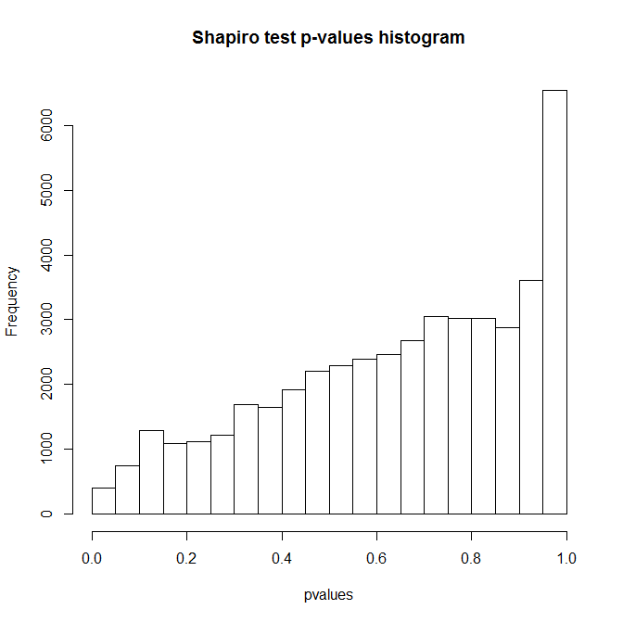
Fig A. For checking the normality of log-transformed gene expressions, we performed Shapiro-Wilks test for each gene and drew a histogram of the p-values. P-values for most genes are larger than 0.05 which means log-transformed gene expressions follow normal distributions.

Slide 2
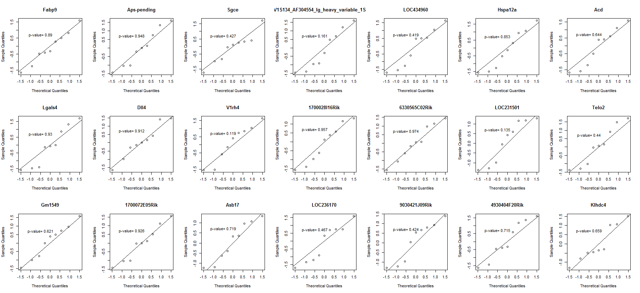
Fig B. QQ-plots for some genes which are significant in model-based approach.

Slide 3
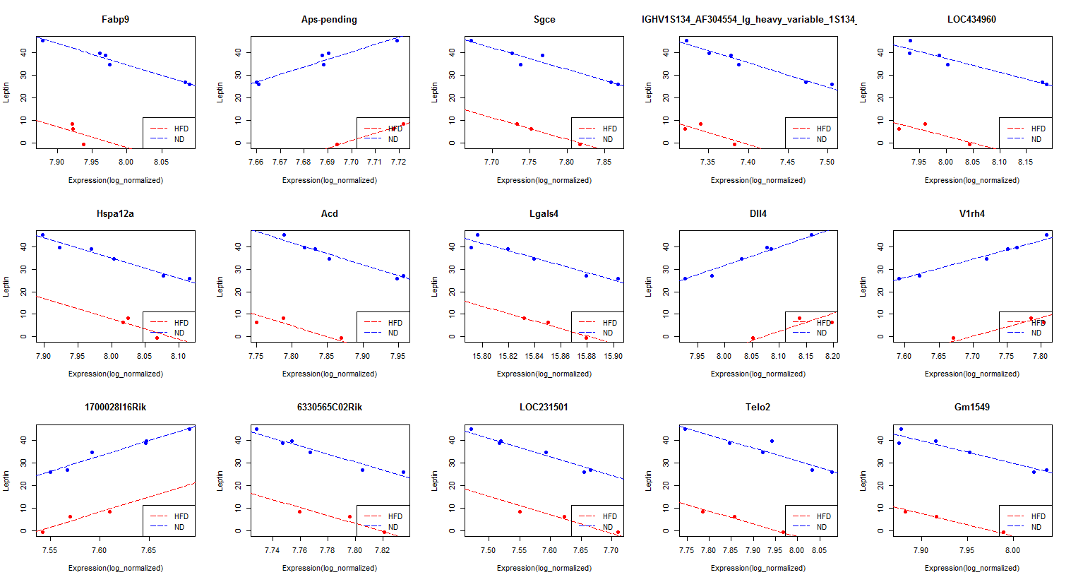
Fig C. Gene expression profiles for significant genes with leptin detected by model-based approach. Blue dots are ND samples and Red dots are HFD samples. X-axis shows log-normalized gene expression for each gene and Y-axis shows expression of leptin.

Slide 4
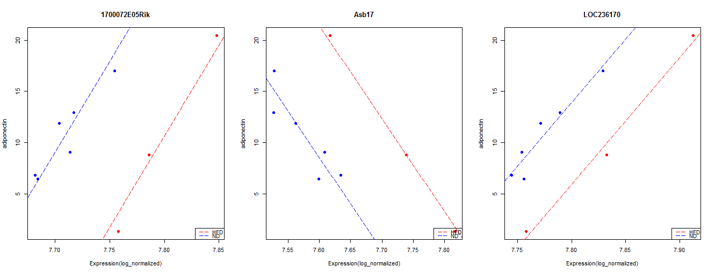
Fig D. Gene expression profiles for significant genes with adiponectin detected by model-based approach. Blue dots show ND samples and Red dots show HFD samples. X-axis shows log-normalized gene expression for each gene and Y-axis shows expression of adiponectin.

Slide 5
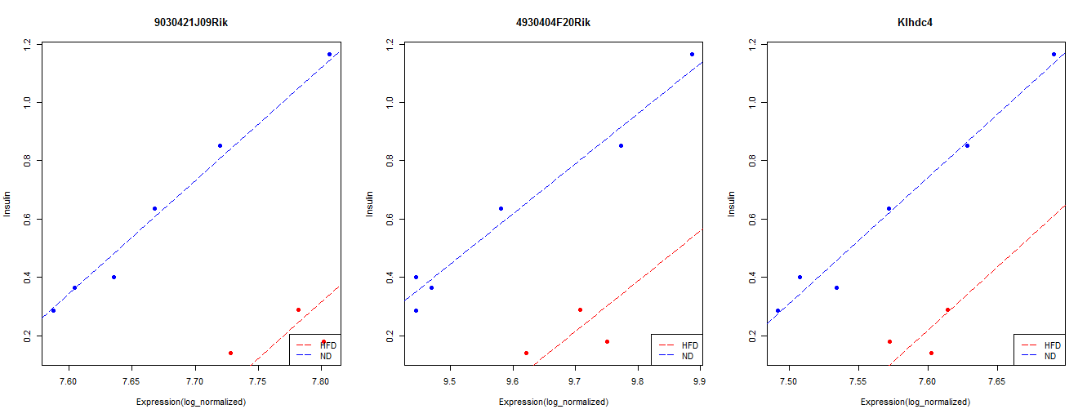
Fig E. Gene expression profiles for significant genes with insulin detected by model-based approach. Blue dots are ND samples and Red dots are HFD samples. X-axis shows log-normalized gene expression for each gene and Y-axis shows expression of insulin.

