Slide 1
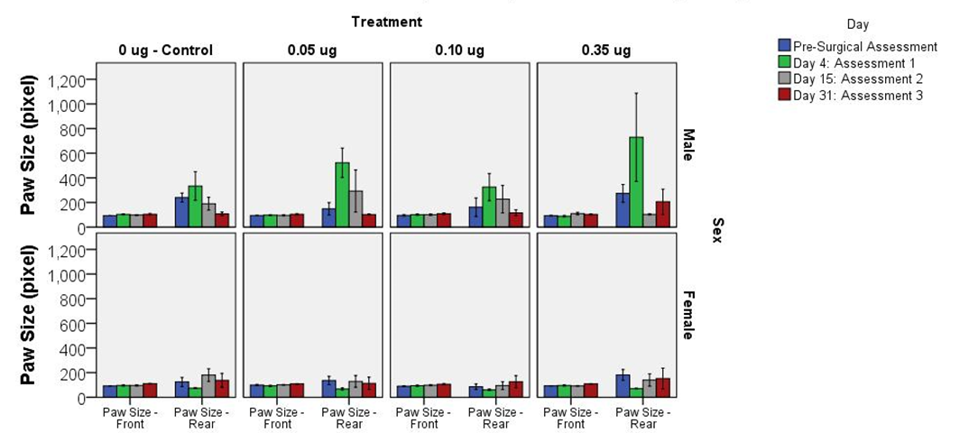
Supplementary Figure S9
“Preclinical Toxicity Evaluation of a Novel Immunotoxin, D2C7-(scdsFv)-PE38KDEL, Administered via Intracerebral Convection-Enhanced Delivery in Rats.” Investigational New Drugs: The Journal of New Anticancer Agents. By: Xuhui Bao, Vidyalakshmi Chandramohan, Randall P. Reynolds, John N. Norton, William C. Wetsel, Ramona M. Rodriguiz, Dipendra K. Aryal, Roger E. McLendon, Edward D. Levin, Neil A. Petry, Michael R. Zalutsky, Bruce K. Burnett, Chien-Tsun Kuan, Ira H. Pastan, and Darell D. Bigner. Corresponding Author: Darell D. Bigner, Preston Robert Tisch Brain Tumor Center and Department of Pathology, Duke University Medical Center, Box 3156, 177 MSRB-1, 203 Research Drive, Durham, NC 27710. Phone: 919-684-5018; Fax: 919-684-6458; E-mail: darell.bigner@duke.edu

