Slide 1
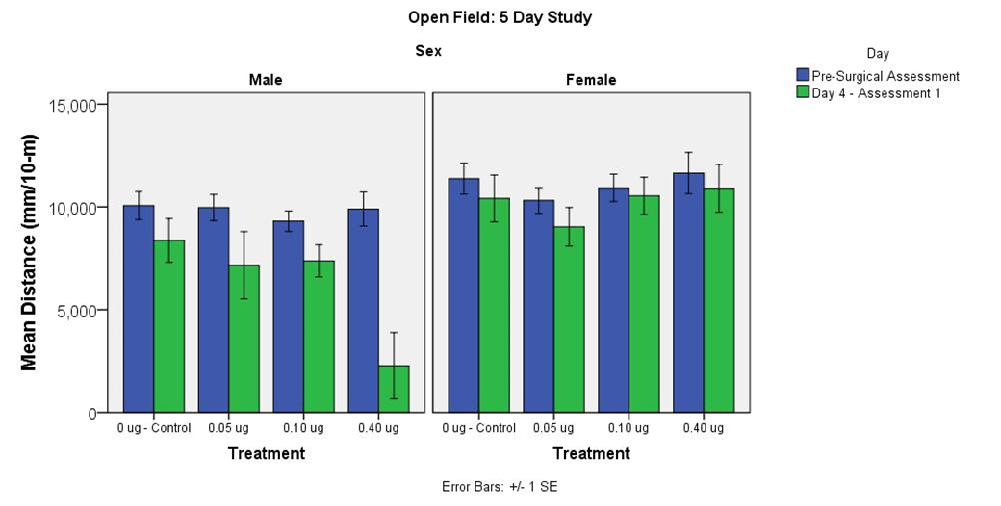
Supplementary Figure S1

