Slide 1
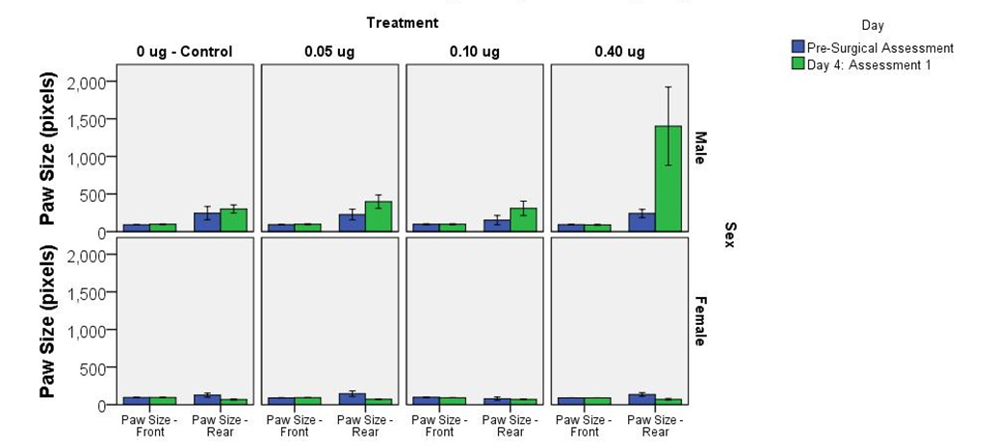
Supplementary Figure S4

